Slide 1
The Future of the Indiana Diploma: Final Diploma Rule
May 15, 2025

Slide 2
Your Presenter:
Ms. Flora Jones, MS. ED
Director of Student Pathways & Opportunities, IDOE
Ms. Jones is a Proud School Administrator and Professional School Counselor with over thirty years of experience in the field of education. She prides herself in being a servant leader who has devoted her life to helping students find their Passion and Purpose and develop a Plan for their future. Before joining the IDOE, she served as the Director of Post-Secondary Readiness for Indianapolis Public Schools where she oversaw college, career, and life readiness initiatives across the district. Prior to her time in IPS, she spent over twenty years in MSD of Wayne Township in various roles including School Counselor, Recruitment Chairperson, Home School Advisor, At Risk Counselor, and GCL New Teacher Trainer, along with many other roles and responsibilities.

Slide 3
TODAY’S AGENDA
Remembering our WHY
Hoosiers Engaged in the Process
Stakeholder Feedback Improves, Refines Final Draft
Example Student Profiles
Implementation Resources & Supports
Rulemaking Timeline & Next Steps
Notes:
Flora 3-12

Slide 4
WHY DO WE NEED TO RETHINK HIGH SCHOOL?
Fewer Indiana students are enrolling in higher education, and even fewer are graduating.
Students are graduating without the skills needed to secure rewarding career opportunities.
Students who dream of enlisting are finding out they are disqualified when it’s too late.
Student apathy is high, leading to high rates of chronic absenteeism in grades 9-12.

Slide 5
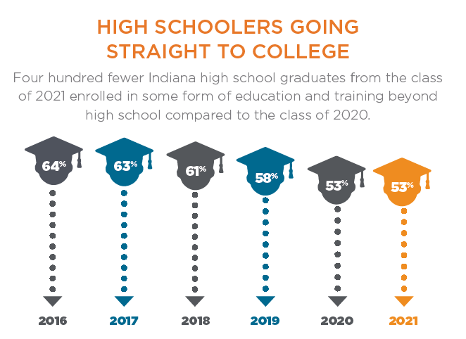
WHY DO WE NEED TO RETHINK HIGH SCHOOL? continued
Fewer Indiana students are enrolling in higher education, and even fewer are graduating.
of Hoosier high school graduates say they intend to go on to some form of higher learning…
76%
53%
actually do…and of these students…
24%
who enroll in a 2-year college or university graduate on-time.
51%
who enroll in a 4-year college or university graduate on-time.

Slide 6
WHY DO WE NEED TO RETHINK HIGH SCHOOL? continued
Students are graduating without the skills needed to secure rewarding career opportunities.
Indiana ranks #1 nationwide in terms of students completing at least one college course in high school.
Top 6 durable skills according to Indiana companies: communication, metacognition, leadership, critical thinking, collaboration, and character.
58% of Indiana jobs require skills training beyond high school, but not a four-year degree.
Ex. work-based learning; short-term credential
Our OPPORTUNITY ahead….
64% of Indiana students earn college credit, graduating high school with an average of 13.5 credits. A short-term credential can be earned with 15-18 credits.
5% of these students earn a credential before graduation, opening doors of future opportunity. Thousands more are just a few credits away…and many aren’t even aware.

Slide 7
WHY DO WE NEED TO RETHINK HIGH SCHOOL? continued
Students who dream of enlisting are finding out they are disqualified when it’s too late.
Nationwide, 2022 was the worst recruiting year in the history of the military’s all-volunteer force.
Enlistments into the military from the state of Indiana declined by 41% from 2018 to 2022.
Indiana National Guard enlistments over the same period declined 38%. The rate of decline is worse in Indiana than in other states.
~77% of student are disqualified because they do not meet the aptitude, medical, fitness, or character standards necessary for service.

Slide 8
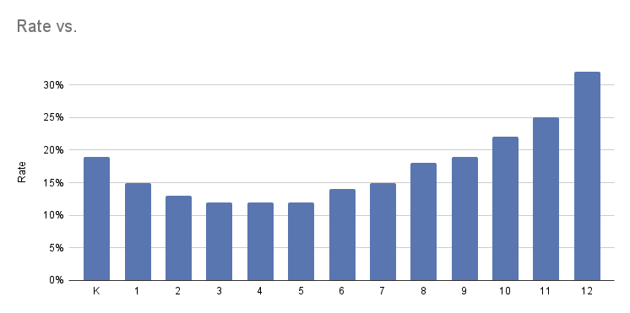
WHY DO WE NEED TO RETHINK HIGH SCHOOL? continued
Student apathy is high, leading to high rates of chronic absenteeism in grades 9-12.
Chronic Absenteeism by Grade Level (2023-2024)
35%
32%
30%
25%
25%
22%
20%
19%
18%
19%
15%
14%
15%
15%
13%
12%
12%
12%
10%
5%
0%
K
1
2
3
4
5
6
7
8
9
10
11
12
Notes:
CHRONIC ABSENTEEISM: By grade level (2023-2024)

Slide 9
THE HIGH SCHOOL EXPERIENCE OF THE FUTURE
OUR SHARED GOAL: The high school experience prepares every student for success, helping them to maximize their educational attainment, regardless of their unique goals and aspirations for the future.
Enrollment
Employment
Enlistment & Service

Slide 10
Remembering our Design Priorities
Maximize flexibility for students to personalize their journey while maintaining rigor
Increase simplicity for students, parents, and schools
Increase access to work-based learning and credentials of value

Slide 11
Final Draft of the diploma rule: overview
The final proposal maintains:
One base diploma
Minimum, flexible requirements for all students
Opportunities for students to earn readiness seals
Aligned with their unique path
Note: The federally-required alternate diploma for students in special education with a significant cognitive disability is still available.

Slide 12
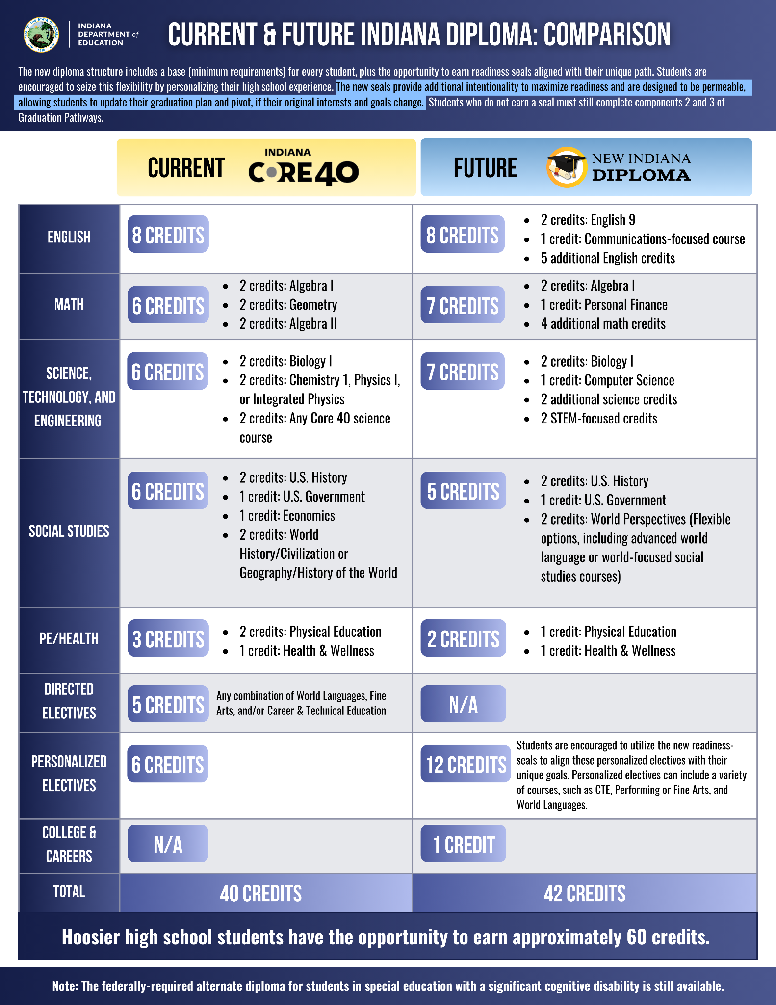
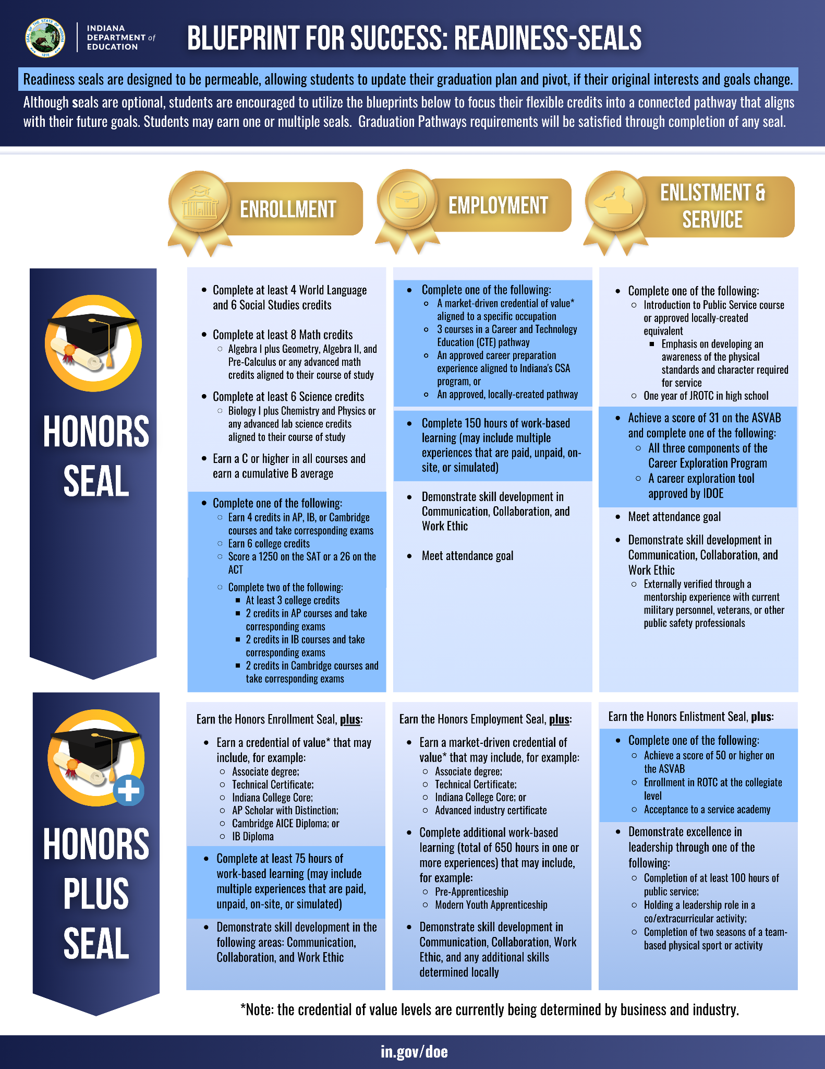
Notes:
Flora!

Slide 13
PATHWAY Permeability FOR STUDENTS
Readiness seals are designed to be
permeable, allowing students to update
their graduation plan and pivot, if their
original interests and goals change.
Feedback: Throughout their high school journey, a student’s unique goals may change, particularly as they gain more experiences and understand the range of opportunities that exist for their future. Seals should maximize permeability between pathway options.
Solution: In addition to the intentional permeability built in to each seal, the diploma rule also explicitly clarifies that students should update their graduation plan throughout their high school journey, as needed.
Notes:
Rebekah 13-19

Slide 14
ENROLLMENT HONORS seal UPDATE
Feedback: Students pursuing the enrollment honors seal should have maximum flexibility in how they demonstrate college-readiness, allowing for a blend of college credit options. Also, requiring students to pass corresponding exams could be an unintended barrier, as students often do not know if they have passed the exams until after graduation.
Complete one of the following:
Earn 4 credits in AP, IB, or Cambridge courses and take corresponding exams
Earn 6 college credits
Score a 1250 on the SAT or a 26 on the ACT
Complete two of the following:
At least 3 college credits
2 credits in AP courses and take corresponding exams
2 credits in IB courses and take corresponding exams
2 credits in Cambridge courses and take corresponding exams
Solution: Similar to the current academic honors designation, students can complete this seal requirement by earning a combination of credits across multiple programs and taking the corresponding exams. Cambridge courses were added as an option for the enrollment honors seal, in addition to AP and IB.

Slide 15
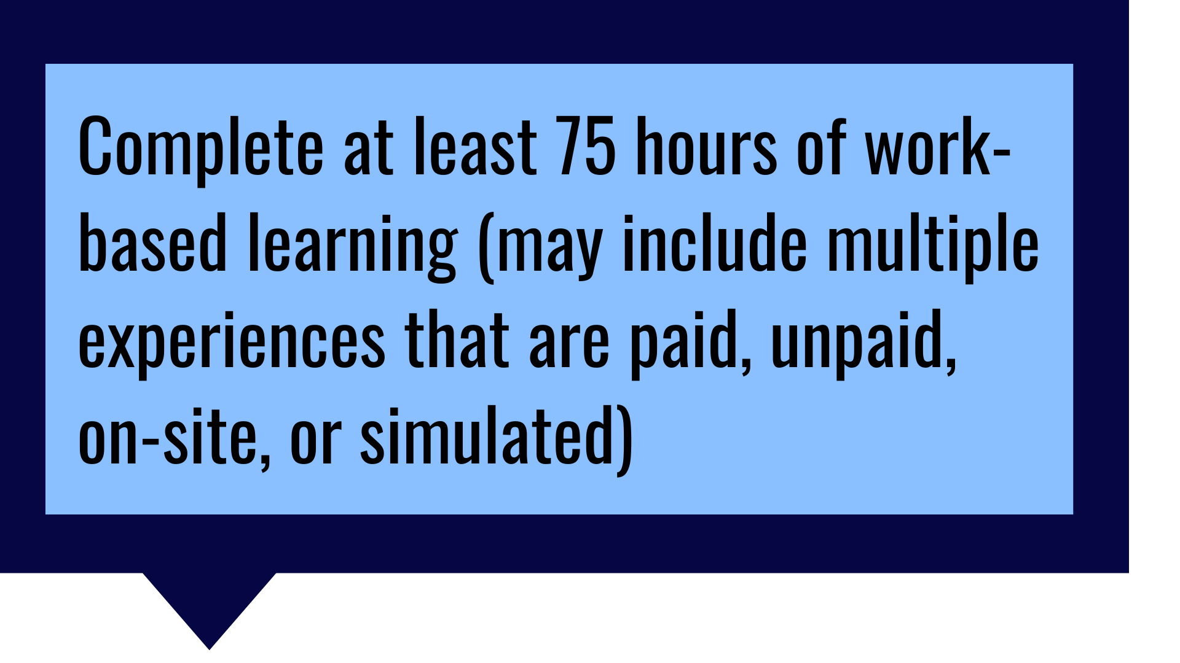
ENROLLMENT HONORS Plus seal UPDATE
Feedback: Current CTE requirements are in 75-hour increments, and if aligned, could provide an additional opportunity to simplify the final diploma rule.
Solution: Students pursuing the enrollment honors plus seal will complete 75 hours of work-based learning, rather than 100. This may include multiple experiences that are paid, unpaid, on-site, or simulated. These experiences may also take place before, during, or after school, as well as during the summer.

Slide 16
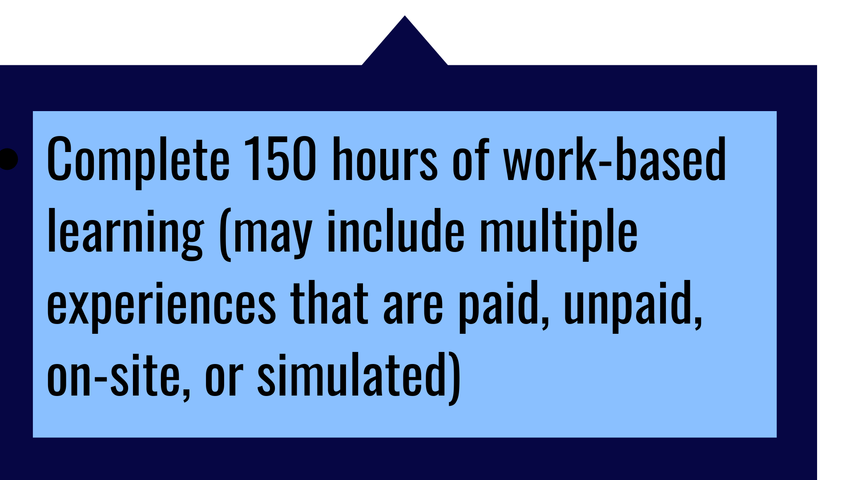
Employment HONORS seal UPDATE
Feedback: Current CTE requirements are in 75-hour increments, and if aligned, could provide an additional opportunity to simplify the final diploma rule.
Solution: Students pursuing the employment honors seal will complete 150 hours of work-based learning, rather than 100. This may include multiple experiences that are paid, unpaid, on-site, or simulated. These experiences may also take place before, during, or after school, as well as during the summer.

Slide 17
Employment HONORS seal UPDATE
Feedback: Students pursuing the employment honors seal should have maximum flexibility in how they demonstrate career-readiness. Expanding to include the CSA program and locally-created pathways options to connect with current policy should be considered.
Solution: In addition to earning a credential of value or completing three courses in a CTE pathway, students can also complete an approved career preparation experience aligned to Indiana’s CSA program or a locally-created pathway.

Slide 18
Enlistment HONORS seal UPDATE
Feedback: The ASVAB Career Exploration Program requires trained facilitators which could reduce flexibility and limit access for students. Other quality career exploration programs should be considered.
Achieve a score of 31 on the ASVAB and complete one of the following:
All three components of the Career Exploration Program
A career exploration tool approved by IDOE
Solution: Since quality career exploration is the focus, in addition to completing all three components of the ASVAB Career Exploration Program, students can now also complete a career exploration tool approved by IDOE.

Slide 19
Enlistment HONORS plus seal UPDATE
Feedback: Students pursuing the enlistment honors plus seal should have maximum flexibility in how they demonstrate preparedness for a variety of military careers, beyond just a single test score.
Solution: In addition to scoring a 50 or higher on the ASVAB, enrolling in ROTC at the collegiate level or being accepted to a service academy will also count towards a student’s seal attainment, as recommended by military leadership.

Slide 20
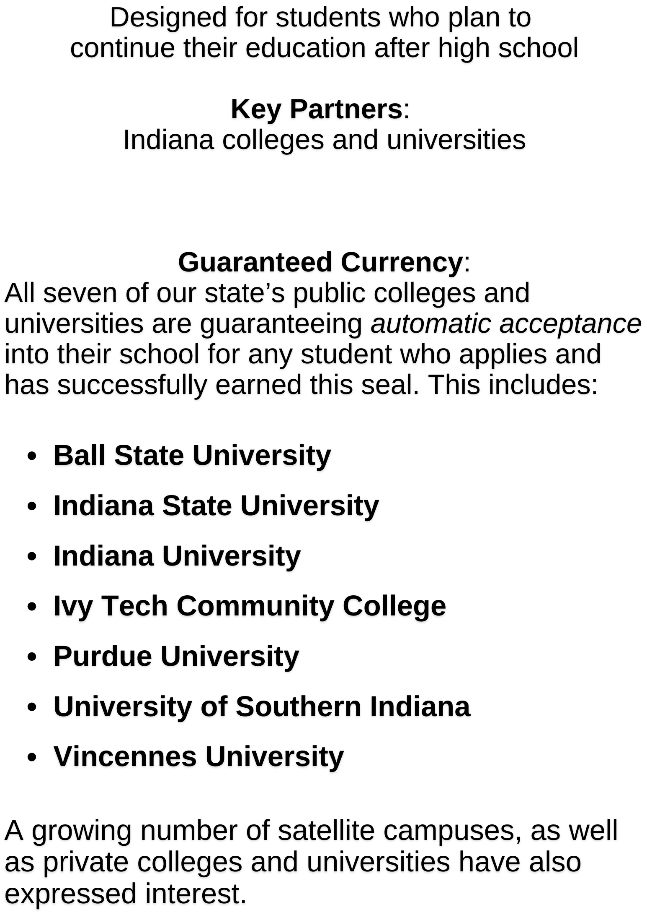
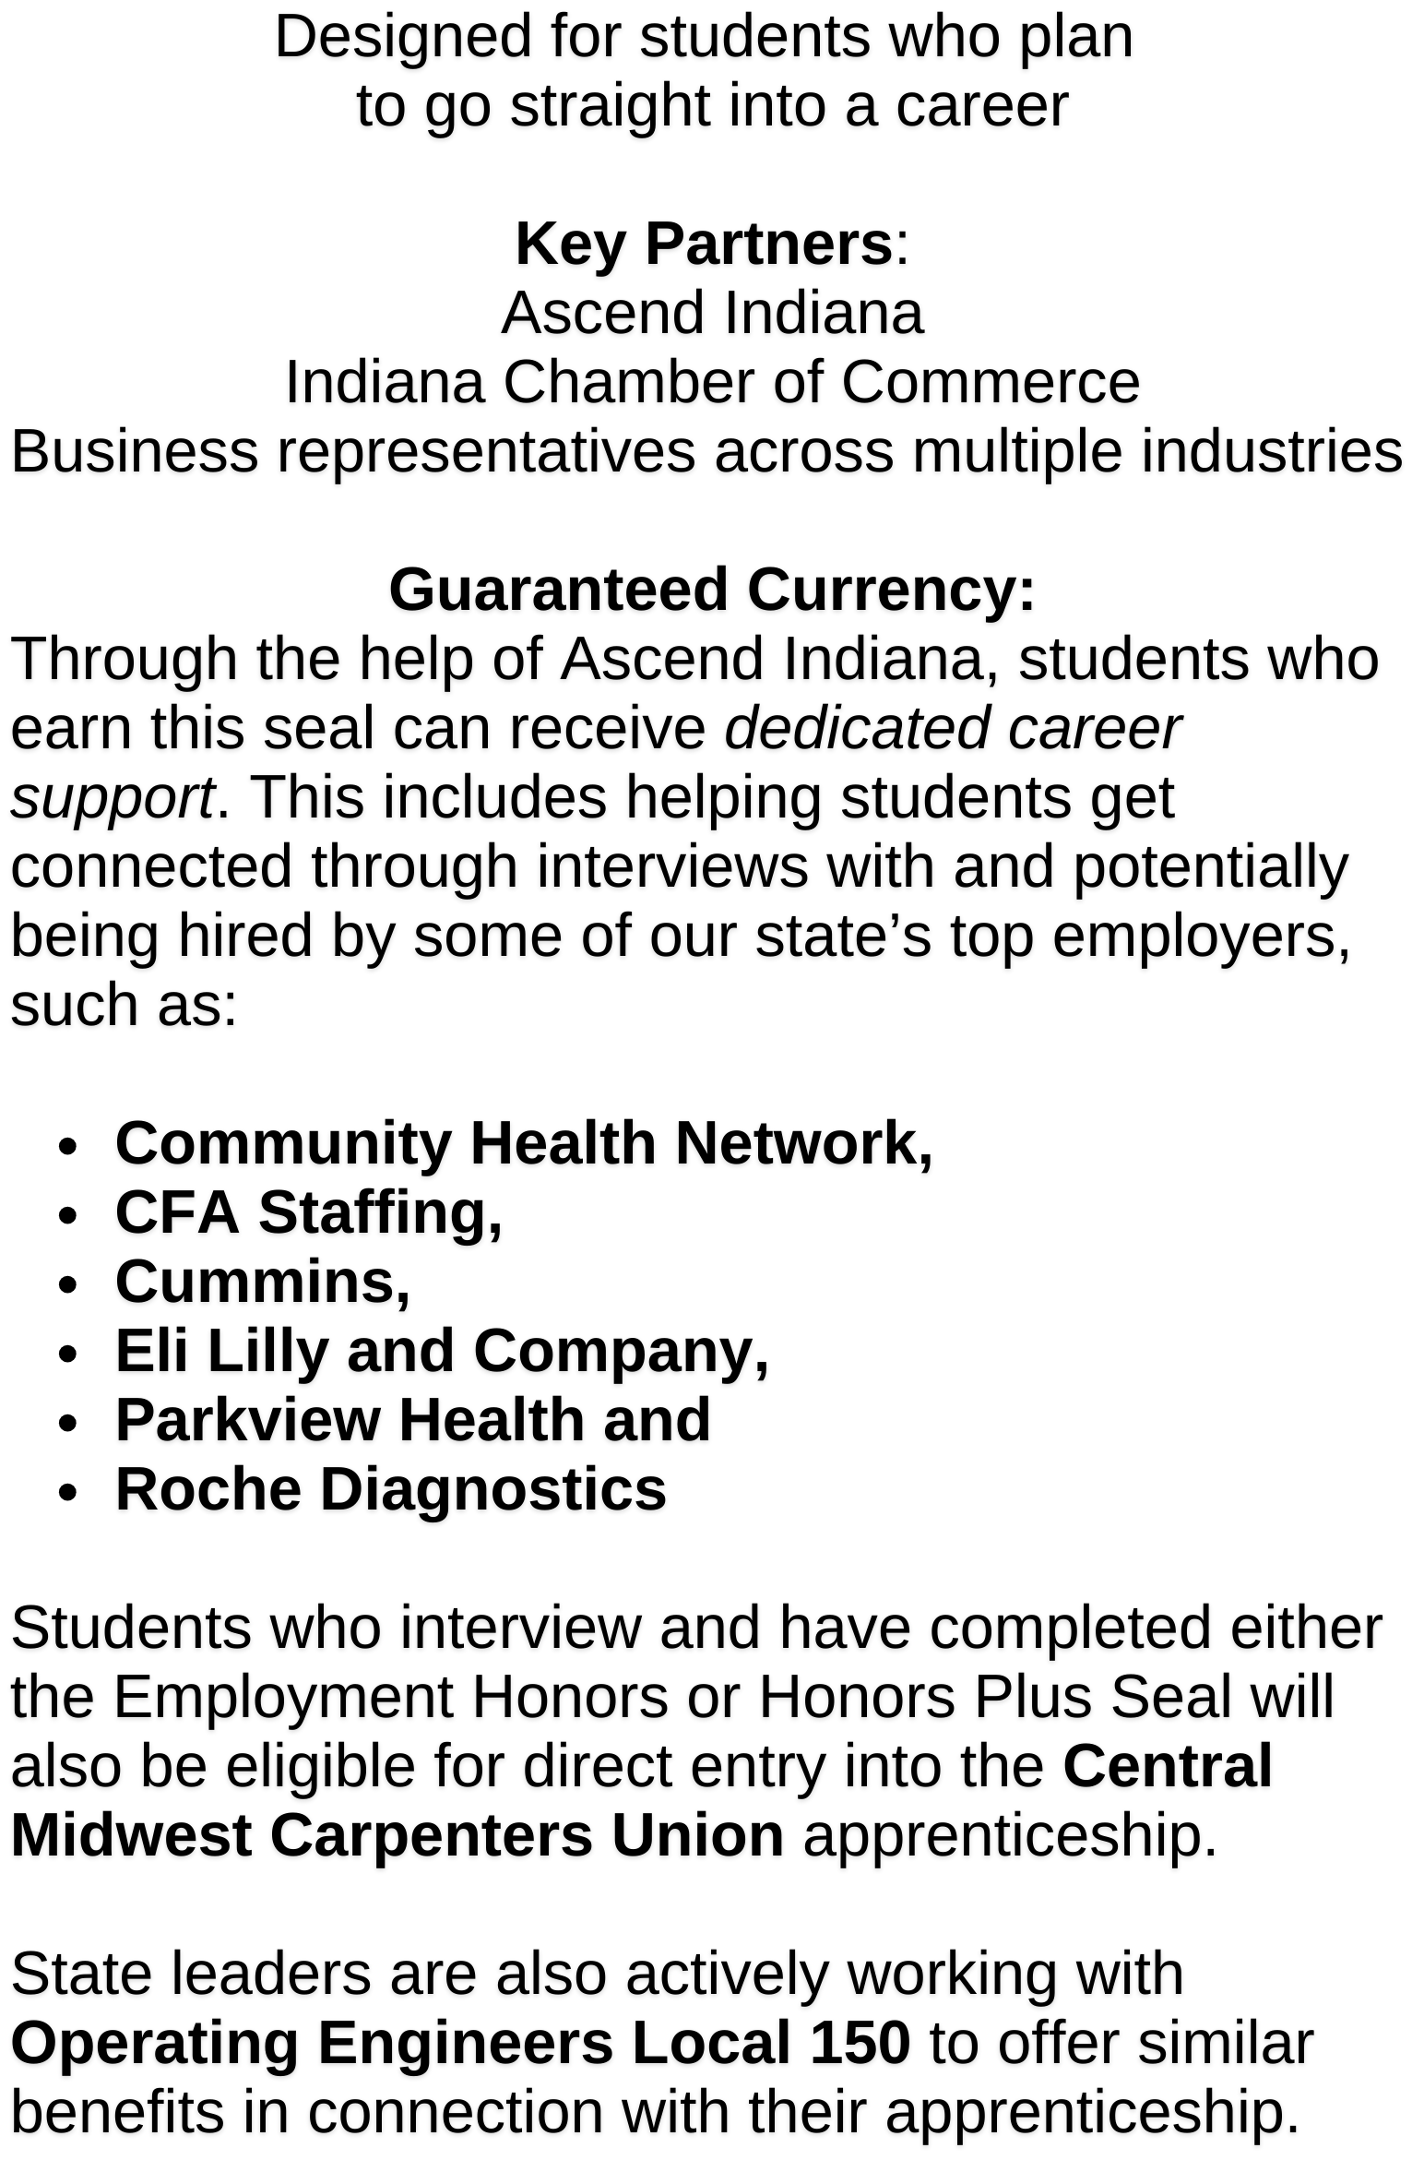
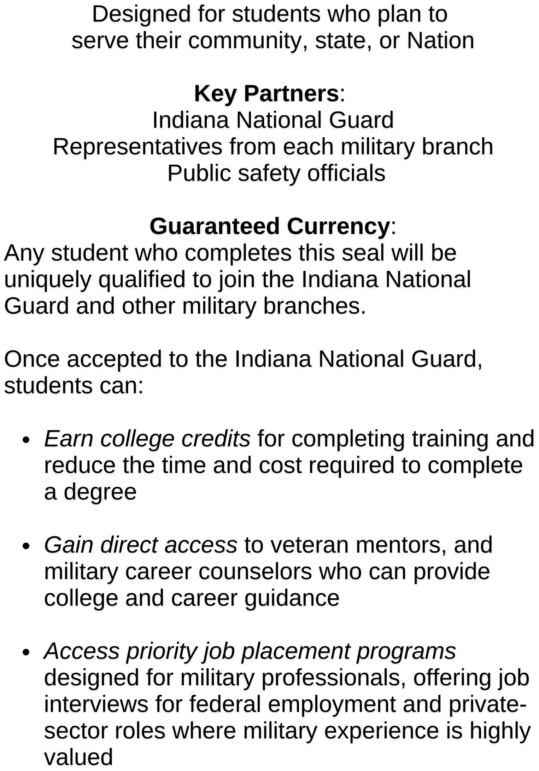
Indiana students and their families must have an education that is personalized to their individual needs and relevant in today’s world. Indiana’s new high school diploma requirements were strategically designed to better connect students with their unique path ahead, whether they plan to continue their education after high school, go straight into a career, or serve in our Nation’s military.
With the increased flexibility in the diploma, new readiness seals provide students and parents with a blueprint for success to achieve their unique goals and aspirations. To ensure the readiness seals have currency and are as valuable as possible for students, Indiana leaders continue to collaborate with stakeholders across the state to provide students a direct path to their future upon completion of a seal. Students may earn one or multiple seals.
As implementation of the new diploma continues, this list of partners will grow to ensure Hoosier students have a more seamless path to their future.
Revised April 2, 2025
Notes:
Flora! 20-the end then both on Q&A

Slide 21
Ensuring all dual credit counts
Feedback: Some students find out after they have already paid for and completed a dual credit course that the course does not transfer to the higher education institution that they plan to attend, or that the course will only count as an elective. Ensuring courses are in the core transfer library is essential to increasing currency for students.
Solution: To increase transparency and currency for students, the updated rule specifies that all liberal arts dual credit courses should be pre-approved for transfer to all Indiana public colleges and universities, as well as some independent colleges and universities effective with credits earned during SY 2029-2030.

Slide 22
Balancing flexibility and rigor
Feedback: With the additional flexibility created through the diploma, including increased opportunities to earn high school credit as an advanced path in middle school (e.g. Algebra I, some CTE, etc), a student could potentially graduate early without maximizing their high school opportunities.
Solution: To best set them up for future success, any student graduating early will be required to earn an honors or honors plus seal in enrollment, employment or enlistment and service.

Slide 23
Implementation Resources & Supports

Slide 24
Implementation resources & supports
Eligible course titles and descriptions, by category; anticipated by Spring 2025
e.g. American Literature for English; Life Science for Science
Memo: New Indiana Diploma Courses Eligibility
Comprehensive work-based learning guidance, including a landscape analysis; anticipated Q1 2025
Current Graduation Pathways Guidance
Complete credential of value list; anticipated Q1 2025
Interactive advising tool to support local implementation; RFP anticipated in Q2 2025
Will engage parents, students, principals, and school counselors to design a tool that increases transparency around pathway options and helps map progress
Increased flexibility on who can teach high school and college courses; anticipated Q2 2025
Rulemaking on new accountability model aligned to diplomas; anticipated to begin in Q2 2025

Slide 25
Rulemaking Timeline & Next Steps

Slide 26
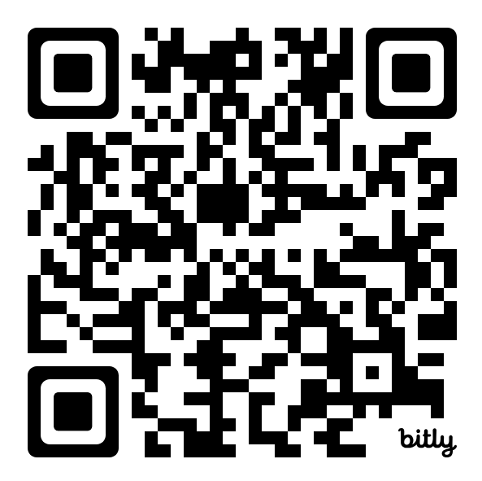
Rulemaking timeline & next steps
Timing | Action Item
2025-2026 School Year | Schools can opt in to award the new Indiana diploma. *cannot opt in this school year **students must earn a seal for opt-in
2028-2029 School Year | Per statute, new diploma is effective for all graduating seniors.
Scan the code to ask questions on the implementation of the new diploma.

Slide 27
Thank you!

