Slide 1
Division of Mental Health and Addiction
Presented May 15, 2025

Slide 2
Sarah Sailors, MSW
Congregate Care
Rural Homebased Casework
Rual and Urban Child Welfare
Executive role within DCS
DMHA Director, March 2025

Slide 3
Director
Sarah Sailors
Data Strategy
Wendy Harrold
System Integration
Howard Simms
Mental Health and Wellness
Vacant
State Psychiatric Hospital Network
Katrina Norris
Chief of Staff
Rebecca Buhner
Recovery Support Service
Niki Howenstine
Addiction Treatment
Kelly Welker
System Transformation Director
Vacant
Director of Behavioral Health Integration
Ahrash Nassiri
Asst. Director of Suicide Prevention and Crisis Response
Lana Lipe
CMHC Funding
Michael Ferry
Quality Improvement
Jenna Ward
Assistant Director of Adult Mental Health and Wellness
Steven Holland
School and Community-Based Programs Director
Bethany Goetz
Assistant Director of Youth Mental Health and Wellness
Tanya Meritt-Mulamba

Slide 4
Legislative Changes
HEA 1385: Provides that a health care facility my employ a person with a felony offense relating to controlled substances within the last 5 years f the person is certified as a peer recovery coach through a credential recognized by DMHA
HEA1167: Exceptions to paraphernalia statutes- provides that the controlled substance paraphernalia statutes do not apply to items marketed to detect the presence of a drug or controlled substance
SEA 505: Emergency Transport to appropriate facility- Adds a mental health facility to list of locations

Slide 5
Legislative Changes
HEA 101: States that a CMHC providing compensation, including salary and benefits, to any employee, (not including clinical staff) more than $400,000 per year cannot receive funding from local property taxes or state programs or grants. Excludes the Medicaid program
Requires FSSA to determine whether outpatient prescription drugs prescribed to Medicaid recipients from a 340B covered entity are eligible for rebates. Allows the secretary to adopt rules needed to implement this section.

Slide 6
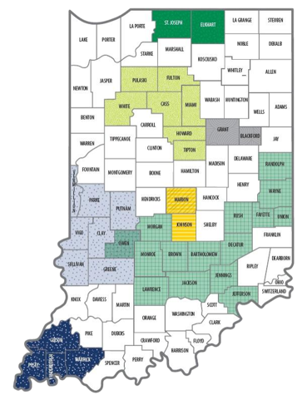
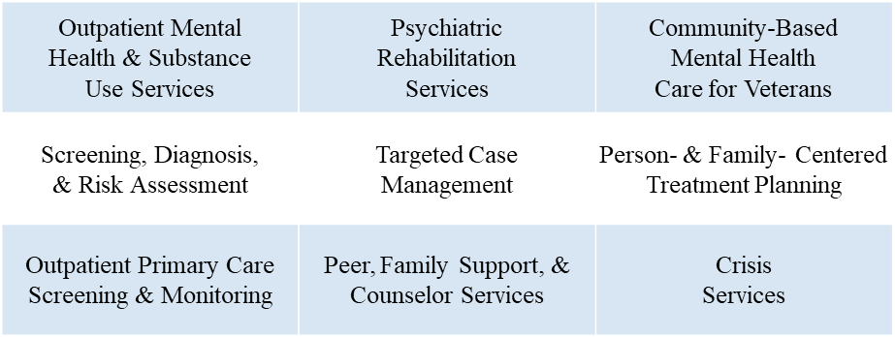
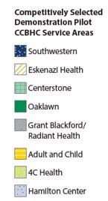
CCBHC Program Overview

Slide 7
Indiana CCBHC SFY25 Q3 Data
30,382 Medicaid Members were served by a CCBHC in Q3 SFY 2025
Average business days between first contact and psychological evaluation
Average business days between first contact and ongoing care
30
CMHC
27
24
CMHC
11
CCBHC
9
16
8
CCBHC
4
SFY23 Q3
SFY24 Q3
SFY25 Q3
SFY23 Q3
SFY24 Q3
SFY25 Q3
Note: Data was calculated using the I-SERV specifications.

Slide 8
988 Indiana Crisis Response System Map
Notes:
Use slide 7 for talking points

Slide 9
Indiana 988 SFY24 & SFY25 Q3 Comparison Data
Pillar 1: 988 Calls
Pillar 2: Mobile Crisis Responses
Pillar 3: Crisis Receiving and Stabilization Services
25,735
96.9%
18,439
95.7%
1,859
1,889
1,468
1,704
1,483
1,199
1,177
1,089
SFY24 Q3
SFY25 Q3
SFY24 Q3
SFY25 Q3
SFY24 Q3
SFY25 Q3
988 Call Volume In State Answer Rate
Number of Unique Individuals Served by Mobile Crisis Teams
Number of Unique Individuals Served by Crisis Receiving and Stabilization Services
Note: First Quarter data for mobile crisis and crisis stabilization units is incomplete as some providers are still submitting data.

Slide 10
Next Steps with CCBHC
Data and outcome reviews
CCBHC manual
Indiana application for participation in the next Cohort

Slide 11
Budget Overview
DMHA lost 18.1M
ISPHN
Recovery Works 13M
SMI 4.5M
SED 730K
Child Psych 726K
One appropriation for all 6 Hospitals
Increase but still below current expenditures
Prioritizing Competency Restoration

Slide 12
DMHA Initiatives
High Acuity Youth
Suicide Prevention Plan
CHANP- Children with High Acuity Needs Project
Governor Initiative
Inter-Agency collaborative approach to problem solving
IC 12-21-5-5 requires a state plan
6 workgroups
Hosting public-facing listening sessions
May 20th 9:30 community members, stakeholders and experts
June 2nd 2pm postvention lived experience

Slide 13
Future State
Hospital Admission and Discharges
Group Home Options
Continuum of Care for all Hoosiers
Youth
Adults
Older person
Youth Mobile Crisis

