Slide 1
Two-Way Trust: Fostering Partnerships Between Treatment Providers and the Courts
Brittany Kelly, J.D., M.S.W., L.S.W.
State Court Behavioral Health Administrator
Office of Behavioral Health, Indiana Supreme Court
Hon. Andrew Williams
Allen County Superior Court
Civil Division

Slide 2
What we’ll cover today
Why courts and treatment providers must work together
Why it feels hard to get on the same page sometimes
Successes and challenges in collaboration
How to build successful relationships between treatment providers and the courts
What’s next for the Office of Behavioral Health

Slide 3
Let’s Chat!
Notes:
Who feels they are well-connected to the courts?
Who wishes they had stronger relationship with the courts?
Who wishes they could teach judges something?
Who wishes they could be taught something by a judge?

Slide 4
State and Local Courts
The justice system is the de facto entry point for obtaining treatment and services.
The criminal justice system is the primary referrer to substance use disorder treatment and largest provider of mental health care.
Correctional institutions have become de facto mental health providers.

Slide 5
Justice System Involvement
People with mental illnesses in the U.S. are 10 times more likely to be incarcerated than they are to be hospitalized
More than 70% of people in American jails and prisons have at least one diagnosed mental illness or substance use disorder, or both
Notes:
Zoe

Slide 6
Once involved with the justice system…
Vicious cycles emerge
in which behavioral health conditions are reasons for court involvement and court involvement often exacerbates behavioral health issues.
Notes:
Zoe

Slide 7
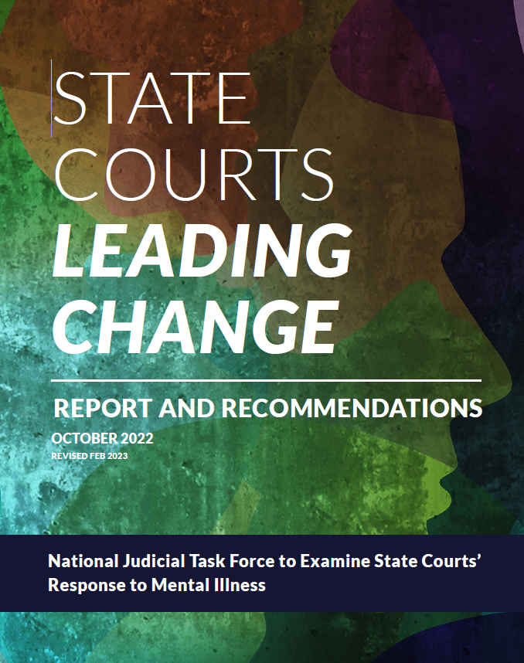
Notes:
Published in February 2023
Chief Rush and Justice Goff were both involved in the creation of this report

Slide 8
Better Together
On state and local levels, behavioral health and justice system stakeholders and community leaders must come together to examine their systems and community resources to determine the best path forward to provide the best care and responses to individuals with mental illness.

Slide 9
Why might it feel hard to get on the same page?
Do the courts and treatment providers have competing priorities at times?
Are we speaking different languages?
Notes:
Judge Williams’ story about competing priorities here- litigant in court- judge Williams had to keep courtroom safe, provider had other priorities

Slide 10
Translation Needed!
Things judges/lawyers aren’t taught
Stages of change
Motivational interviewing
Trauma informed care
Medications and diagnoses
Things treatment providers aren’t taught
How to interpret the law
Navigating the justice system
Procedural elements of a court case
How to testify or make an argument in court
Relapse prevention strategies

Slide 11
How do we build trust?
A story from Judge Williams
Notes:
What can treatment providers do to help judges trust their expertise? (detailed tx plans w/ options and reasoning, show up to court, provide wraparound services)
What can judges to do help treatment providers have trust in the courts? (deference to tx plans)
What stressors are judges dealing with?
What stressors are treatment providers dealing with?

Slide 12
We asked you!
17 respondents from 14 different facilities
“Please share your most common challenges when working with the justice system on behalf of a client.”
“Please share any successes you have had when working with the justice system that led to a better outcome for a client.”

Slide 13
We asked judges!
Annual Judicial Conference 2024
“Please share your most common challenges when trying to connect with a treatment provider in your community.”
“Please share any successes you have in developing relationships with treatment providers in your community.”

Slide 14
Challenges reported by providers
Deference to Treatment Plan
Let the clinicians evaluate and determine what is clinically appropriate.
Communication
When the communication loop is broken down, it can impact client care and outcomes.
Navigating Expectations
Stigma
Combating stigma around harm reduction and medications for the treatment of SUD.
Timelines of treatment world and the judicial system can differ.

Slide 15
Challenges reported by the courts
Wait Time
Time between court referral and participants’ first actual session.
Access
Availability of beds.
Funding
Options for litigants who can’t pay.
Need for Connection
I don’t know my treatment provider or what services they offer.

Slide 16
Communication, Collaboration, Relationships
“We all want the same thing- healthy people and safe communities.”

Slide 17
Where to Start- Somewhere!
Ask for a meeting
Make the court aware of your services
Who can be their point of contact?
Establish regular meetings
CCBHC services
Discuss challenges and opportunities
Develop cross-training
Learn each other's lingo

Slide 18
Creation of the Office of Behavioral Health
OBH prioritizes behavioral health related needs of Indiana's courts and the litigants they serve by connecting judicial officers and justice system professionals to resources in their communities, providing education on matters of behavioral health, and supporting the work of the Behavioral Health Committee.

Slide 19
Conference of Chief Justices and Conference of State Court Administrators: Resolution 1
“Consider the appointment of a behavioral health director/administrator and a team within the Administrative Office of the Courts to develop and implement improved court responses for court-involved individuals with serious mental illness.”

Slide 20
Indiana was the Tenth State to fulfill Resolution 1
Idaho, Illinois, Indiana, Iowa, Kansas, Kentucky, Maryland, Massachusetts, Michigan, Minnesota, Missouri, New Mexico, Oregon, Pennsylvania, Texas, Vermont, Washington, Wisconsin, Wyoming (19)
Notes:
Indiana should be so proud.
Thanks to Chief Justice Rush
And growing everyday!
OR and WI just joined!!

Slide 21
Office of Behavioral Health: The First Year
Serve as a resource to Indiana’s Judicial Officers
Competency, AOT, connection to resources, training, etc.
Support the Behavioral Health Committee
15 judges working to create an Indiana Behavioral Health Action Plan
Peers in courts, juror trauma, best practice language, etc.
Foster key stakeholder relationships
DMHA, Indiana Council of Community Mental Health Centers, and many more
Educate the judiciary and justice system stakeholders
Judicial Conferences, two-way training for treatment providers and judges, DMHA Competency Forum, etc.
Offer guidance to the Office of Judicial Administration

Slide 22
Behavioral Health Committee
Hon. Stephanie Campbell, Chair Fountain County
Mag. Lisa A. Berdine Lake County
Hon. Murielle Bright Jennings County
Hon. Jonathan Cleary Dearborn County
Mag. Elizabeth Hardtke St. Joseph County
Hon. Gina Jones Lake County
Hon. Amy Jones Marion County
Late Hon. Michael Kramer Noble County
Mag. Jill R. Marcrum Vanderburgh County
Hon. Douglas K. Mawhorr Delaware County
Hon. Lisa Garcia Reger Clark County
Hon. Emily Salzmann Monroe County
Mag. Joel Schneider Marion County
Hon. Rhett Stuard Hendricks County
Hon. Andrew Williams Allen County
Notes:
Chair, Judge Stephanie Campbell, this group raised their hands to serve on this newly formed committee
Granted technical assistance by the State Justice Institute to craft an Indiana specific behavioral health action plan, written by judges for judges
PLEASE STAND AND BE RECOGNIZED
Please find them throughout today’s events

Slide 23
Behavioral Health Committee Workgroups
Deflection and Diversion to Treatment
Education
Competency
Data/Funding

Slide 24
What’s Next for OBH (with your partnership)
Assisted Outpatient Treatment Programs
Court Navigation
Continued Collaboration

Slide 25
Contact OBH for support and to share ideas
Brittany Kelly
317-234-4113
Brittany.Kelly@courts.in.gov

