Slide 1

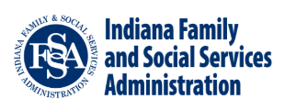


Indiana’s Children with High Acuity Needs Project
Project Overview

Slide 2
Agenda
Work Group and Work Stream Selection Review
Jack’s Journey
Workstream Overviews
Current Status

Slide 3

Project Objective &
Improvement Opportunities
A multi-agency workgroup began by identifying 35 improvement opportunities for children with high acuity needs while the steering team developed an overarching North Star Objective.
Involved Agencies
DCS, DOC, DOE, FSSA (DMHA, OMPP, BDS, DDRS)
North Star Objective
Support and serve children with high acuity needs and their caregivers with responsive, collaborative, strengths-based, and continuous care to ensure Hoosier children can live happy and fulfilling lives in the community.
Community-Based Services - Sample Improvement Opportunities | Residential & Acute Services - Sample Improvement Opportunities
Implement community-based programs to support children and families post discharge Expand access to and quality of existing community-based programs (including Wraparound, CMHC services for ID/DD, SED) Improve access to prevention services in schools Expand access to respite care | Re-examine the role of gatekeepers and identify actionable improvement opportunities Expand residential and/or acute programming for youth that present with high acuity needs Support/encourage existing QRTPs in developing options/treatment for youth with high acuity needs
Notes:
DMHA Workgroup Participants
Katrina Norris
Leslie Hulvershorn
Sirrilla Blackmon
Amber Becker

Slide 4




Selection of Core Work Streams
Multiple state agencies continue to actively collaborate on four work streams and the Rapid Response Team to improve Indiana’s service array for children with high acuity needs.
Inputs
Workgroup's 35 improvement opportunities | State Leadership Feedback | Project Executive Team Input
Core Work Stream Details
CMHW/I Program Review | Cross-Agency Navigator | Intensive Foster and Respite Care | Gatekeeper Process Review
Conduct review of the CMHW and CMHI programs to identify strengths and improvement opportunities | Links access points to care coordination across State agencies and programs | Provides specialized foster care and respite care through intensively trained foster parents | Implement enhanced gatekeeper responsibilities with pilot sites & consider updates to administrative code
Rapid Response Team – Emergent Case Support
55+ Youth Supported to Date by a Multi-Agency Team

Slide 5






Meet Jack
The following journey map visualizes the experience of Jack*, a child with high
acuity needs navigating Indiana’s system of behavioral, mental, and developmental supports.
Behavioral and Developmental Health
Diagnoses: oppositional defiant disorder, severe depression with self-harm behavior, developmental disabilities (IQ: 75)
Family History
Lives with biological parents, who fight often, and two siblings
Witnessed mental and physical abuse between his parents
Changes to Behavior
Began exhibiting aggressive behaviors to classmates and teachers in middle school
Increasing incidence of self harm
Entering Adolescence
14-year-old male
High school freshman
Big Indiana Fever fan
Subsequent Results
Recent physical assault of a younger sibling
Parents struggling to find care to ensure Jack’s and the family’s safety
*Jack is a hypothetical representation of a Hoosier child with high acuity needs based on data and workgroup members’ experience.

Slide 6










Jack’s Journey
This map shows a hypothetical journey Jack could experience through Indiana’s system, prior to changes being implemented.
4
2. Change of placement/ homebound
4. Jack enters kinship care
2
1
2
Waitlisted for in-state
and out-of-
state
residential care
1. IEP & history of multiple suspensions
6. Self-harm activity leads to ED
6
7
7. Admitted to State Hospital
3. The change in placement puts additional stress on Jack’s parents work schedule and they cannot meet his needs
5
5. Jack enters Residential Care
3

Slide 7

Jack’s Journey - Improvement Opportunities
The project’s core work streams impact various points of Jack’s potential journey through Indiana’s system.
Cross-Agency Navigator provides system-wide care coordination consultation to program coordinators serving children at-risk of expulsion
Intensive Foster Care utilizes highly trained foster parents to provide holistic care to meet acute needs and maintain placement stability
CMHW/I Services offer intensive support for mental/behavioral needs to increase stability in the community
4
2. Expulsion
4. Jack enters kinship care
1
2
6. Self-harm leads to ED
8. Return to community care
1. IEP & Homebound
6
7
8
3. Parents cannot meet Jack’s needs
7. Admitted to State Hospital
3
Cross-Agency Navigator provides system- wide care coordination consultation to children in NDI
CMHW/I Services provide comprehensive community-based care that supports mental/behavioral needs
5
5. Enters Residential Care
Intensive Respite Care provides short-term care from highly trained caregivers to provide
rest for families
Gatekeeper Process Changes increase resources for gatekeepers to provide more comprehensive care

Slide 8





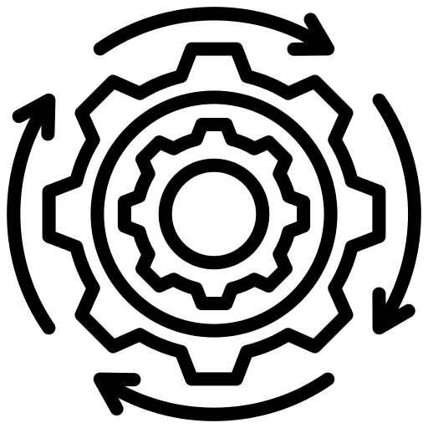
CMHW/CMHI Program Review
CHANP is expanding on the previous work completed around the Child Mental Health Wraparound (CMHW - DMHA) and Children’s Mental Health Initiative (CMHI - DCS) programs to consider opportunities to better serve children with acute/complex needs in the community.
Project Goal | Identify improvement opportunities and possible cost containment options through a collaborative effort to improve Wraparound services for children and families across the continuum of care, regardless of diagnosis, insurance, or agency involvement.
Current Activities
 | Holding stakeholder engagement sessions with relevant agencies (ex. Office of Medicaid Policy and Planning) and wraparound providers
 | Mapping existing services to determine service gaps and other barriers
 | Developing and refining improvement opportunities for state leadership consideration
Next Steps
 | Synthesize feedback from stakeholder survey
 | Provide improvement opportunity recommendations to CHANP Steering Team and State Executive Leadership
 | Implement any selected improvement opportunities

Slide 9




Cross-Agency Navigator Pilot Overview
The Cross-Agency Navigator pilot provides system-wide expertise and complex case management support for children with high acuity needs.
Identified Problem | Siloed programs with staff that lack system-wide knowledge make it difficult for children with acute needs to access appropriate services in their community.
Program Goal | Manage complex cases using specialized, multi-agency expertise to supplement existing state and local programs to increase quality outcomes and decrease inefficiencies with effective referrals.
Pilot Program Areas
School-Based Prevention
Identify appropriate community services to prevent crises for students with an Individualized Education Program and acute needs
Target Population
Children who are at risk of removal or already removed from school or other modified instruction
Desired Pilot Outcomes
Manage comprehensive educational case plan
Secure proper services so children remain in school
Prevent crises that put stress on the system
Decrease use of costly institutional care
State Psychiatric Hospital (SPH) Step-Down
Support the identification of appropriate treatment & step down placements for kids discharging from SPH
Target Population
Children who are not in an appropriate placement (i.e., medically necessary length of stay, least restrictive environment) and have other agency involvement
Desired Pilot Outcomes
Identify appropriate discharge options quickly
Facilitate sustainable step-down to community
Reduce length of time on waitlist
Decrease likelihood of overstaying in SPH care

Slide 10
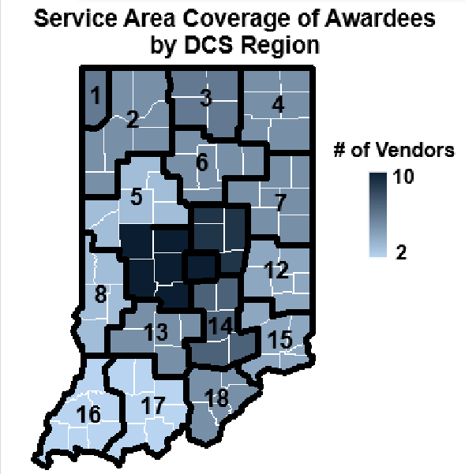


Intensive Foster and Respite Care
As of 11/1/2024, 13 providers began providing intensive foster and respite services for children at a level of care better suited to their needs. Currently, there are over 200 children enrolled in this program.
 | Key Program Features
Foster Parent and Kinship Caregiver Training | Foster parents and kinship caregivers receive more intensive training to provide care for acute needs
Additional Support Services | Services include a wide range of offerings that may include but are not limited to: casework, therapy, wraparound services, education, parent training, etc.
Intensive Respite Care | Available to any child with intensive needs whose referral is accepted, regardless of their involvement with DCS
Service Area Coverage of Contractors by DCS Region
11
9
10

Slide 11




Gatekeeper Process Review
The State has executed standalone gatekeeper contracts that add service requirements, performance measures, and funds for the 8 CMHCs selected in the CCBHC demonstration.
Gatekeeper Role | The gatekeeper is the clinical liaison that facilitates admission to and discharge from the state hospital. Currently, this role is housed in Community Mental Health Centers (CMHCs).
Improvement Opportunity | Scope of Work Component
Gatekeeper Check-in Frequency | Require that gatekeepers meet with the patient and communicate with the treatment team within seven days of admission and every 30 days, ideally in-person
Discharge Planning from Admission | Require that gatekeepers start discharge planning at admission and track a ready-to-discharge metric
Performance Requirements and Tracking | Include performance measures, tied to payment, around minimum interaction with patients, team members, as well as timely discharge
Financial Incentives of Gatekeeper Role | Provide payment for CMHCs to complete gatekeeper responsibilities and travel
Gatekeeper Pilot Sites | 4C Health | Adult and Child Mental Health Center | Centerstone of Indiana | Sandra Eskenazi Mental Health Center
 | Hamilton Center | Oaklawn Psychiatric Center | Radiant Health Services | Southwestern Behavioral Healthcare
Note: Implementation of changes to the pediatric gatekeeper process will consider and coordinate with the CCBHC transition

Slide 12
Rapid Response Team Overview
The Rapid Response Team continues to provide cross-agency, emergent case support for youth with high acuity needs.
Interagency collaboration between DCS, FSSA (BDS, DMHA, and OMPP), and the Governor’s Office to identify emergency placement options
Total Youth Served by RRT (to date): | 55+
Top Placement Locations at Time of Referral
Acute hospital, medically cleared for discharge | Local DCS office for > 23 hours | Residential assessment unit
Youth served by RRT exhibit complex behaviors, have multiple diagnoses, and history of placement disruptions as a response to their lived experience and trauma
Key Lessons Learned | Collaboration Enhances Multi-System Support
 | Team Support and Unity | Holistic Approach to Treatment
 | Identification of Service Gaps | Evolving Landscape of Services

Slide 13






Current Status
CHANP has achieved key accomplishments across each workstream and the team continues work on next steps.
Workstream
Key Accomplishments
Next Steps
CMHW/CMHI Program Review
Met with program team to discuss growth opportunities and held external stakeholder meetings
Select improvement opportunities and begin implementation
Cross-Agency Navigator
Prepared for pilot launch in July and began service provision
Continue data tracking and pilot support
Core
Intensive Foster & Respite Care
13 contracts went live on 11/1/24; estimated annual savings of $31M compared to residential care
Monitor progress/outcomes and refine program implementation
Gatekeeper Process
Developed new standalone gatekeeper contracts for select CMHCs
Support data tracking
Funding & CJI Pilot
Secured funding for all programs
Developed CJI pilot proposal
Soliciting feedback on CJI pilot proposal from key stakeholders
Project-Wide
Data Tracking
Developed goals and corresponding metrics for the project and facilitated data tracking process
Continue to support, refine, and present results from data tracking
Stakeholder Engagement
Publicly announced the project and developed materials for stakeholder meetings
Prepare for CISC and POPAI stakeholder presentations

