Slide 1
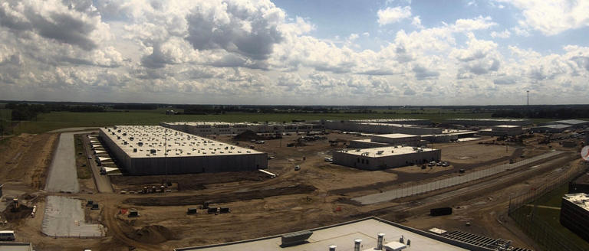
The Indiana Department of Correction:
Updates, successes and continued challenges
Neil Duchac, DrPH, Ed.D., Ph.D., LMHC, LSC, NCC, ACS, HS-BCP

Slide 2
“When we are no longer able to change a situation, we are challenged to change ourselves.”
Viktor E. Frankl, Man's Search for Meaning

Slide 3
IDOC Mission
To promote public safety by providing meaningful, effective opportunities for successful re-entry.

Slide 4
Goals for today
To share background statistics relative to the Indiana Department of Correction.
To discuss mental health specifically within the Indiana Department of Correction.
To foster a respectful dialogue, considering that there are many different views and perspectives.
Provide general updates in correctional behavioral health in Indiana

Slide 5
Behavioral Health
Mental Health
Addiction and Recovery Services
Staff wellness

Slide 6
Questions to Guide our Discussion
What are some statistics related to the Indiana Department of Correction?
What are some of the recent successes within the IDOC?
What are some of the continued challenges?
How can the community be helpful and engaged?

Slide 7
Assumptions for today
Everyone who is incarcerated deserves humane treatment
Everyone should be treated by competent professionals
Not everyone in prison is guilty
Approximately 30 percent of those incarcerated have a mental health condition
Approximately 70 percent of those incarcerated have a SUD
Mental health and substance use impact thoughts, feelings and behavior and influence suicidality
Not all suicides are preventable
We will be discussing prisons, not jails
Staff within corrections are in need.

Slide 8
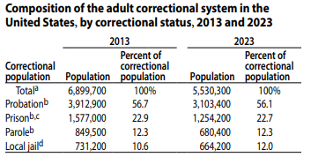
Prison Statistics

Slide 9
About the Indiana Department of Correction
There are a total of 21 institutions statewide.
Vary in security levels from re-entry to maximum security.

Slide 10
Current Mental Health Treatment

Slide 11
Specialized Units
New Castle Psychiatric (NCP) • Further stabilization of acute psychotic symptoms • Recent serious suicide attempts • Recent serious, frequent, or extreme self-injurious behavior, including substance use • Assessment and clarification • High security risk patients requiring mental health unit placement | Pendleton INSIGHT (Intent on Shaping Individual Growth with Holistic Treatment) Treatment Unit (IRT) • Additional need for either transitional treatment and/or structured environment • Patients meeting criteria for Serious Mental Illness and currently housed in Restrictive Status Housing, who are security appropriate for an open milieu treatment environment • Patients who require a transitional level of care and do not require placement at a facility with an infirmary for medical needs • Patients who have co-occurring disorder behavioral health needs

Slide 12
Specialized MH Units
Wabash Valley Correctional Facility Special Needs Unit (SNU)
• Additional need for either transitional treatment and/or structured environment
• Patients for whom placement in a double cell is an appropriate and anticipated component to transition back into a general population setting
• Patients meeting criteria for Serious Mental Illness and currently housed in Restrictive Status Housing who are security appropriate for an open milieu treatment environment
• Patients who require a transitional level of care and require placement at a facility with an infirmary for medical needs
• Patients who are diagnosed with cognitive disorders who require some prompting or support to complete ADL
Indiana Women’s Prison Special Needs Unit (IWP SNU)
• Further stabilization of acute psychotic symptoms
• Recent serious suicide attempts
• Recent serious, frequent, or extreme self-injurious behavior, including substance use • Assessment and clarification
• Additional need for transitional treatment and/or structured environment
• Patients meeting criteria for Serious Mental Illness and who would be placed in Restrictive Status Housing who are appropriate for an open milieu treatment environment

Slide 13
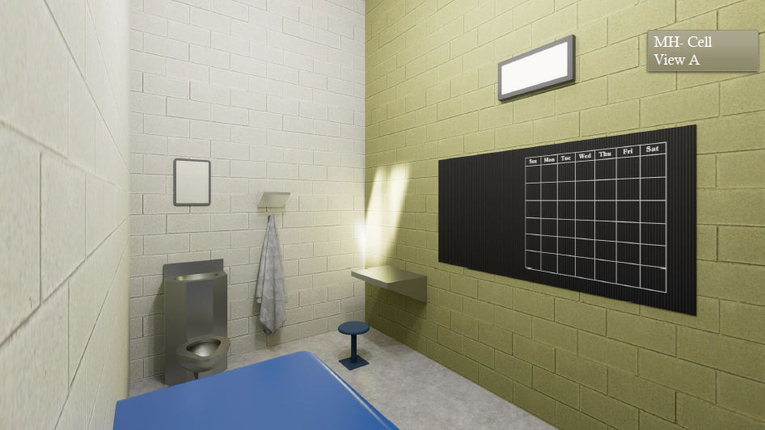
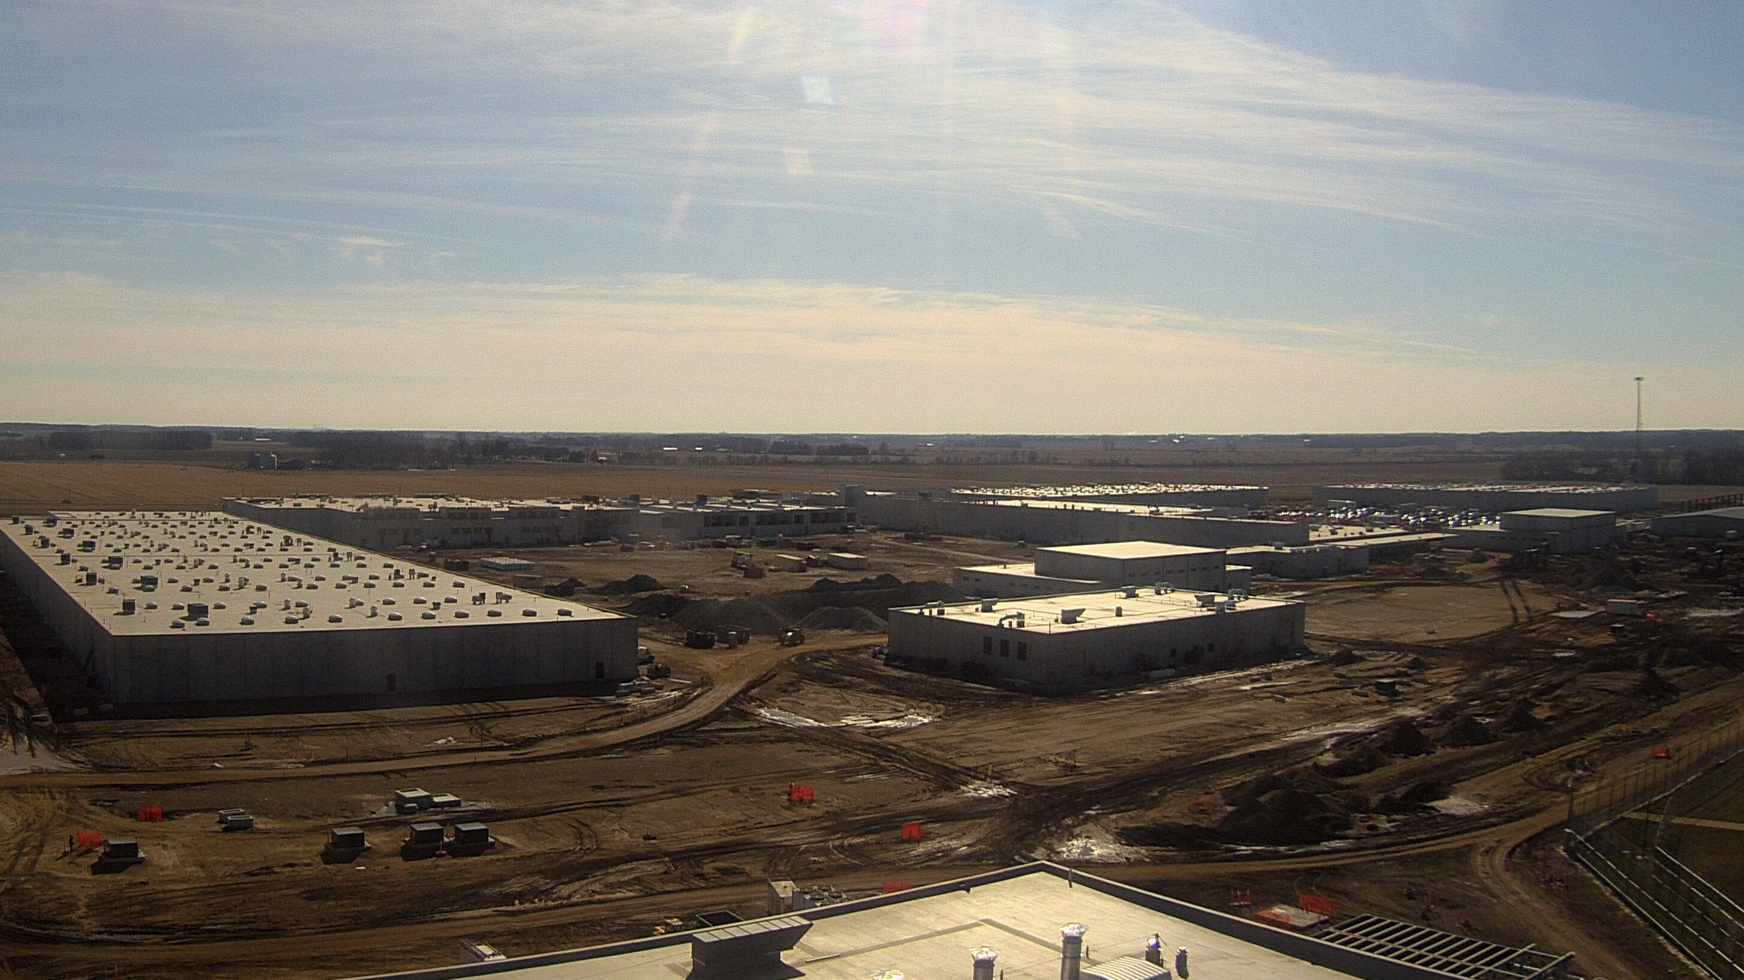
Westville State Prison
Notes:
A new prison is being constructed at the site of the former Westville Correctional Facility; the new prison will be called Westville State Prison. It is the first IDOC facility where living space was specifically designed to support behavioral health treatment rather than having space defined for other uses adapted to accommodate treatment.

Slide 14
WSP Beds
Mental Health Pod 1 (highest acuity) – 24 beds Pod 2 (hybrid acuity) – 24 beds Pod 3 – 24 beds Pod 4 – (low acuity) 40 beds | ARS Pod 1 – 16 beds Pod 2 – 16 beds Pod 3 – 32 beds Pod 4 – 32 beds
H1 ARS Outpatient/Special Needs Acclimation Program/ ARS Outpatient – 52 beds SNAP – 52 beds | Gen Population and Intake Intake – 112

Slide 15
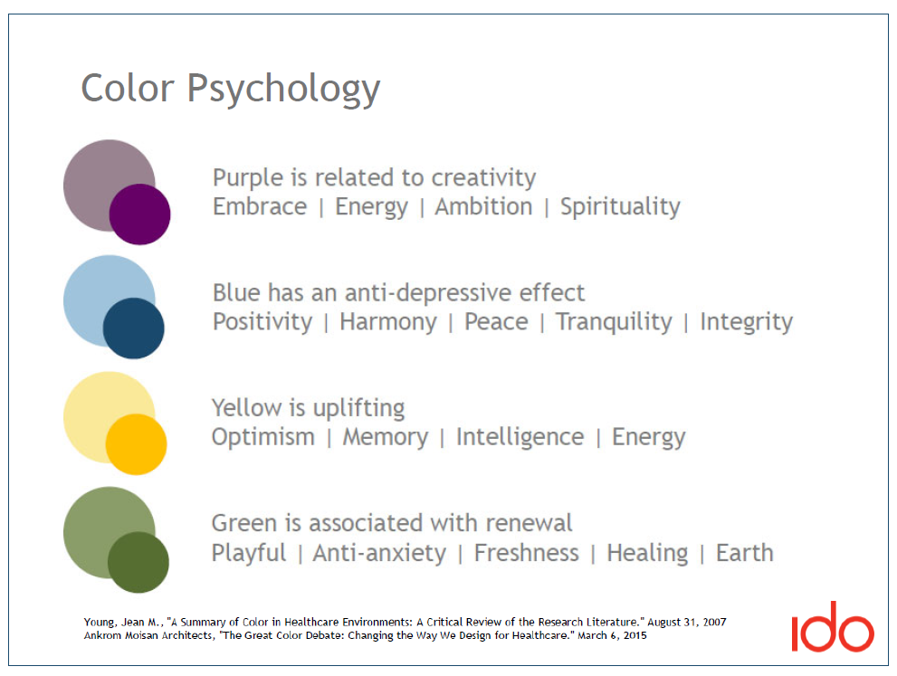
Color schemes

Slide 16

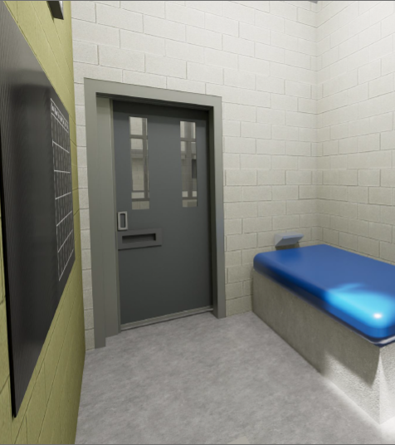
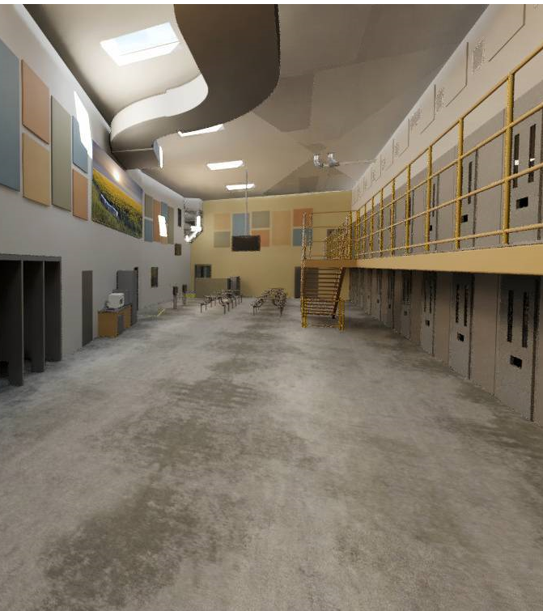
Cell Projections

Slide 17
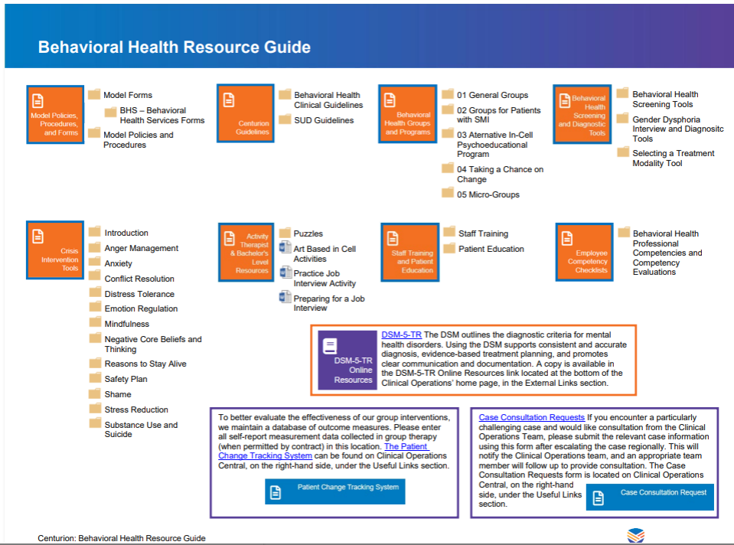
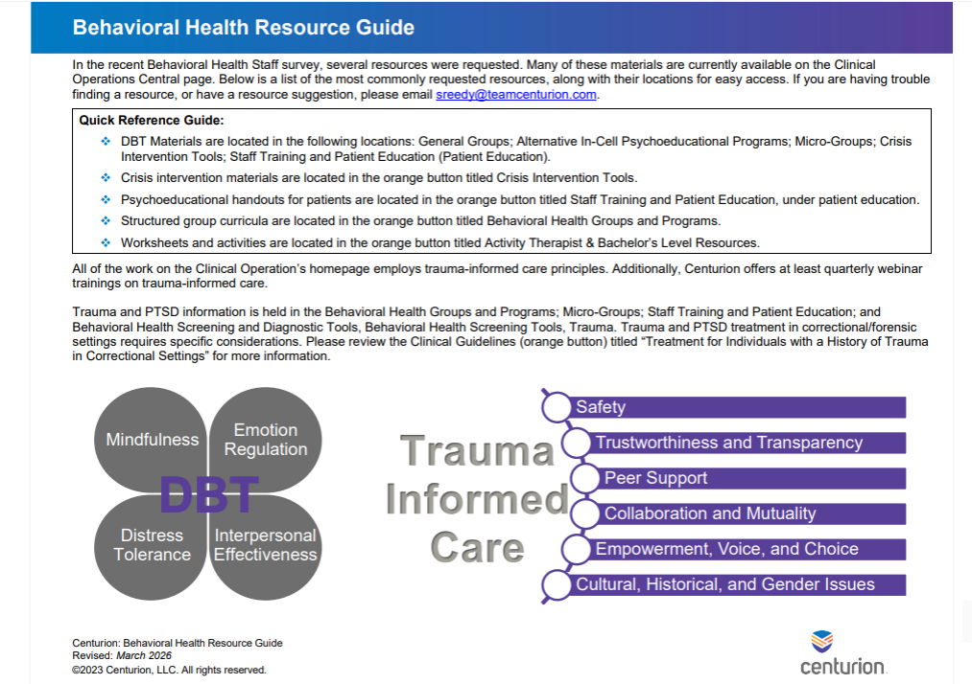
Treatment Interventions

Slide 18
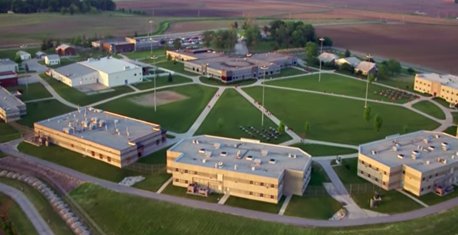
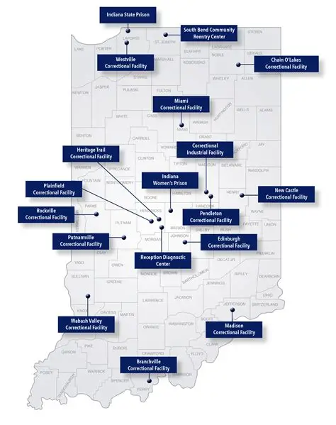
Adult Facilities
Notes:
There are three prisons for females who are incarcerated; Rockville Correctional Facility serves as the intake facility. There are 15 prisons for males who are incarcerated; Reception Diagnostic Center is the location where males go through intake.

Slide 19
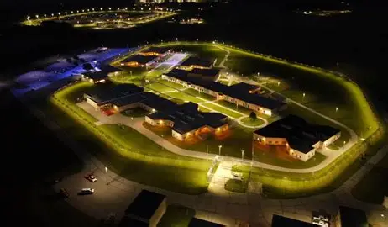
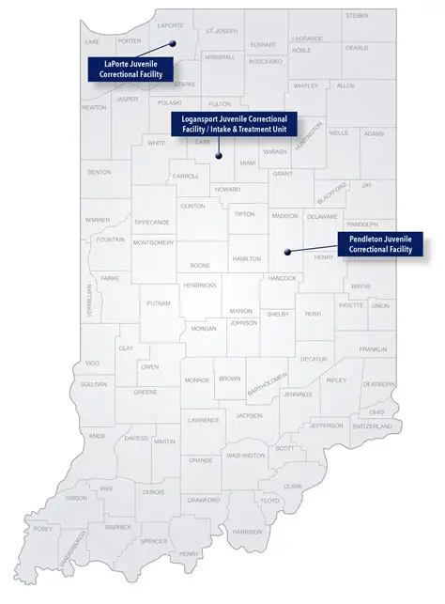
Juvenile Facilities
Notes:
There are three juvenile facilities; LaPorte Juvenile Correctional for females and Logansport and Pendleton Juvenile Correctional Facilities for males. Males go through intake at Logansport.

Slide 20
Population Breakdown (12/31/2025)
Adults
Average age 41.4- 26,288
89.8% male, 10.2% female
60.9 % white, 32.5% black, 0.9% multiple
American Indian/Alaskan 0.2%, Asian 0.4%
Cost per day $85.44
Juveniles
Average age 16.8- 310
88.1% male, 11.9% female
46.8% white, 31% black, 11.6% multiple
American Indian/Alaskan 0.6%, Asian 1.3%,
Asian/Pacific Islander 0.3%
Cost per day $383.42
DMHA state hospital bed- $2033/day

Slide 21
BH Services Provided During Incarceration
Psychiatric appointments
Counseling by Psychologists, Social Workers, Mental Health Counselors, trainees, interns, bachelor-level providers (groups)
Crisis Intervention/ stabilization/ specialized units (mental health units for patients with mental illness and cognitive impairment, Recovery While Incarcerated substance use treatment units)
Short-term counseling/ groups
Integrated recovery services
Medication Assisted Treatment
Restrictive Housing Unit treatment and reviews
ICE detainees

Slide 22
BH Code classifications
A: Free of functional behavioral health impairment in the current living environment; individuals with short-term, self-limiting condition requiring minimal behavioral health intervention limited to thirty (30) days’ duration.
B: Psychiatric disorder that causes little functional impairment and requires infrequent psychiatric services. These services are routine in nature.
C: Psychiatric disorder that causes some functional impairment and requires psychiatric and/or psychological services to support an acute need or recent mental health crisis such as situational social stressors. Services necessary to provide stability, support and skills for self-management such as evidence-based group treatment, peer-led support, or regular psychiatric services. These services may be routine and/or unplanned in nature and may involve mental health monitoring.
D: Psychiatric disorder that requires frequent individual psychiatric and/or psychological services and/or the individual has a history of one or more of the following:
a. a serious suicide attempt and are newly (within the last year) admitted to the IDOC; and/or,
b. have had a serious suicide attempt or a serious self-injury within the last year; and/or,
c. who are on involuntary medication for the treatment of a mental health condition.
E: Psychiatric disorder that causes significant functional impairment such that the individual is unable to function in a standard prison environment and/or causes significant risk of harm to the individual or others and requires structured psychiatric and/or psychological services. Services needed are provided in a specialized mental health unit.
F: Substance Use needs that cause functional impairment; may only include patients who would otherwise have an “A” behavioral health code and whose clinically indicated need for treatment is provided by Recovery While Incarcerated or Medication Assisted Treatment (MAT). This code may also be used for patients with an identified history of overdose but who are unwilling to accept treatment and do not qualify for involuntary treatment.

Slide 23
Code Statistics (1/20/25)
Total Prison Population 26,362 (* Does not include ICE detainees)
Code A 12,092 (45.87%)
Code B 1529 (5.8%)
Code C 4,607 (17.48%)
Code D 951 (3.6%)
Code E (1.15%)
Code F (26.06%)
Unclassified (0.03%)

Slide 24
Female Code Statistics n=2377
Codes | A | B | C | D | E | F | U
IWP | 128 | 105 | 253 | 43 | 30 | 69 | 0
MCU | 269 | 99 | 298 | 24 | 0 | 216 | 0
RTC | 153 | 116 | 518 | 62 | 0 | 94 | 0
 | 550 | 320 | 1069 | 129 | 30 | 379 | 0

Slide 25
BH Codes Juvenile n=336
Codes | A | B | C | D | E | F | U
LaPorte | 8 | 3 | 32 | 2 | 0 | 0 | 0
Pendleton | 16 | 6 | 52 | 52 | 2 | 29 | 0
Logansport | 11 | 7 | 85 | 2 | 0 | 29 | 0
TOTAL | 35 | 16 | 169 | 56 | 2 | 58 | 0
Notes:
Just noting that 46% of the adult population does not have any identified BH concerns compared to 10% of youth.

Slide 26

What are the biggest problems we are facing in correctional mental health today?
This Photo by Unknown Author is licensed under CC BY-SA-NC

Slide 27
Concerns- General
Dual loyalty- Client or corrections. Safety is always paramount
Autonomy
Confidentiality
The utilization of isolation and restrictive housing
Access
Assessment/ Accurate diagnosis
Telehealth
Suicide/ Attempts/ Self-directed violence
Rehabilitation
Marginalized populations
Politics

Slide 28
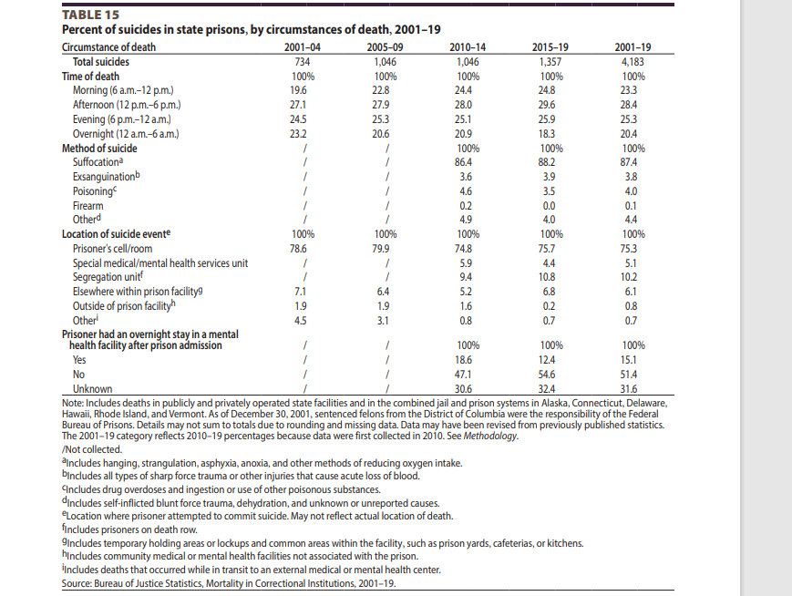
Circumstances

Slide 29
State of Indiana Prison Suicide Information

Slide 30
Indiana Numbers
2019- 12
2020- 11
2021- 10
2022- 12
2023- 14
2024- 12
2025- 19
2026- 7
91 total 98.9% men
78% (n=71, white)
17.6% (n=16, black)
3.4 % (N=4, other)
2025- 89.5% hanging
Spread out at 6 prisons
2025
Age 20-29- 2
Age 30-39- 9
Age 40-49- 5
Age 50-59- 2
Age 60-69- 1
7 of 19 individuals who died by suicide did not have an identified mental health disorder

Slide 31
Addiction and Recovery Services
Continued Certified Peer Recovery Coach training at 6 facilities (New Castle, ISP, Pendleton, IWP, CIF, Putnamville) during 2026/2027 that will put a potential for 162 new CPRC into the workforce
Creation of procedures to provide substance use treatment at WSP BH Unit for individuals previously housed in Restrictive Housing Units and were not able to attend treatment groups
Updated MAT policy that now requires patients to participate in substance use treatment a minimum of 90 minutes per month or be enrolled in active group LOC treatment to continue medications
LAI pilot at Wabash Correctional and for those leaving IDOC
Potential research on cost effectiveness and LAI

Slide 32
Behavioral Health Updates

Slide 33
Mental Health
Focus on being proactive versus being reactive
Suicide prevention- increasing the number of suicide companions
Re-imagining what treatment clusters could look like throughout the state
Re-distribution of treatment providers to areas of more potential need
Preparing to open WSP
Removing the silos between mental health, ARS and staff wellness and recognizing all of these areas as BEHAVIORAL HEALTH

Slide 34
Mental Health Continued
More training for Incarcerated Individuals related to suicide prevention
Added information and resources on their tablets
Increasing peer led groups and providing resources
Collaborating with other professions in the prison such as the chaplain
Enhancing treatment team communication and collaboration
Educating all staff on the significance of behavioral health
Engaging everyone
More trauma informed care is needed

Slide 35
Staff Health and Wellness
The IDOC Staff Health and Wellness Department is committed to and exists to support the well-being of all department staff by promoting the 8 dimensions of wellness. We strive to create a safe, healthy, and resilient workforce by providing accessible wellness resources and fostering an environment where every employee feels valued, supported, and empowered to thrive both on and off the job.
Our team is composed of one staff wellness director, and volunteer wellness champions across all facilities and parole districts. Wellness Champions support wellness across their facilities by promoting engagement, connecting staff with resources, and partnering with leadership and the Staff Health & Wellness Department to strengthen morale and overall well‑being. Wellness Champions are individuals who model and encourage wellbeing across all eight dimensions by showing empathy, supporting healthy habits, fostering connection, sharing knowledge, creating a healthy environment, guiding staff to financial resources, and encouraging purpose and meaning.

Slide 36
Staff Health and Wellness
We regionalized the Wellness Champions to strengthen connection and collaboration. Each region hosted quarterly district meetings where Champions came together to share resources, align on initiatives, and support one another in addressing the unique wellness needs of staff.
So far in 2026, the team has facilitated seven department-wide wellness initiatives, including Heart Health Month, Mental Health Month, and others designed to support staff across the state.
Through these efforts, 42 state-sponsored and community wellness resources were shared across all 31 DOC sites, reaching 21 facilities and 10 parole districts. This year’s initiatives also featured a series of Mental Health Myth Busters, helping staff separate fact from fiction and make informed choices about their mental health and well‑being.

Slide 37
Juvenile System
A decrease in the Department of Child and Family services has resulted in an increase in the juvenile correctional population because support services that were previously financed are no longer feasible within a community setting.
Increase in mental health cases within youth services
Increase in those with intellectual and developmental disabilities
More trauma informed care is needed
We have dedicated staff working tirelessly in this area.

Slide 38
Ongoing Needs
Grant money
Collaboration with the community
Recognition that Correctional mental health, ARS, and staff wellness are important not only in the field, but also within the community
Spreading the word that an investment in corrections is essential as 94% of those individuals incarcerated in state and federal prisons will be released, at some point and become our neighbors.
Transitional care is vital. Though often released, people are serving longer sentences and are having more health and mental health related concerns.
Retention of competent staff and treatment providers.

Slide 39
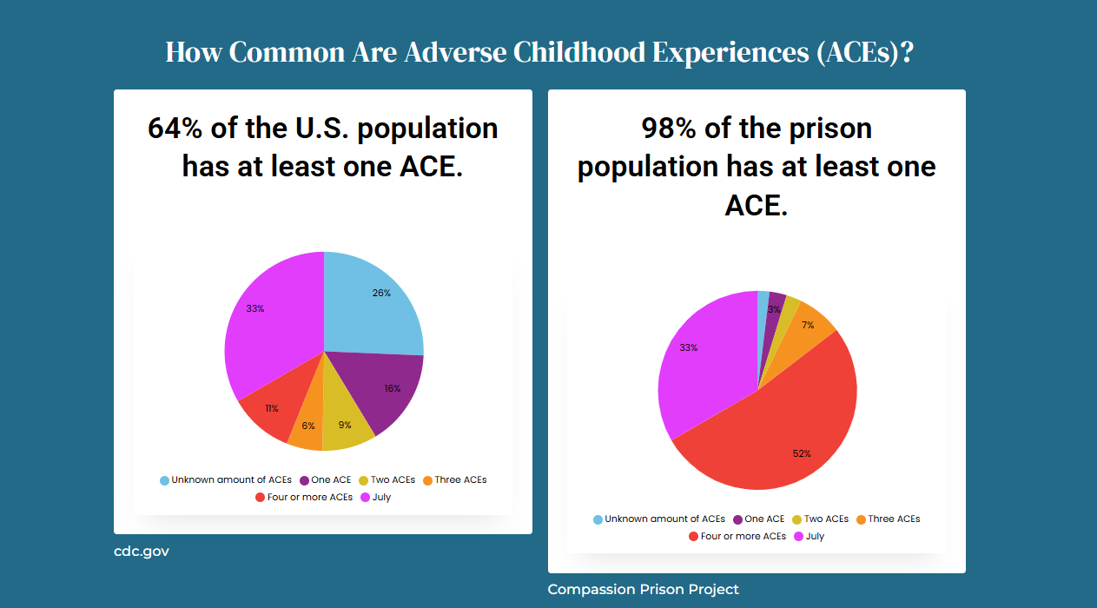
Adverse Childhood Experience

Slide 40
Questions, Thought, and Comments
Contact information
nduchac@idoc.in.gov

