Slide 1


Indiana Medicaid
Community Engagement Overview
Indiana Council of Community Mental Health Centers

Slide 2
Agenda
Legislative and Policy Roadmap Review
Key Legislative and Policy Dates
Community Engagement
  Requirements Overview
  Exemptions
Verification Process and Timelines
Indiana Medicaid Programs
Resources and Next Steps
Questions

Slide 3

Legislative and Policy Roadmap Review

Slide 4
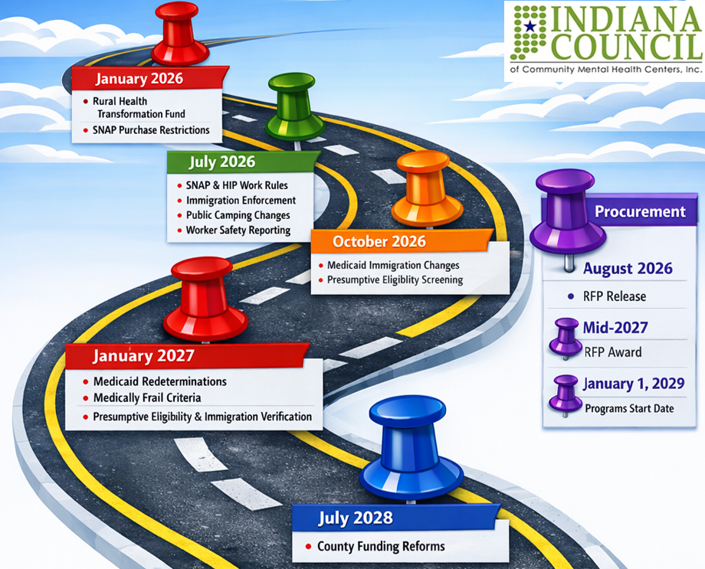


Legislative and Policy Operational Roadmap | 2026 – 2028

Slide 5

Key Legislative and Policy Dates

Slide 6
Indiana Medicaid Community Engagement | Key Dates
Date | Event
July 2025 | HR 1 (One Big Beautiful Bill or OBBB) passed by Congress, creating federal Medicaid community engagement requirements
March 2026 | SB 1 passes, portions of which modify state law to align with federal requirements and establish Indiana-specific policy decisions
June 2026 | CMS issues Interim Final Rule Medicaid Program | Community Engagement Requirement for Certain Individuals (CMS-2454-IFC) Comment period open until July 31, 2026, for feedback and concerns
July 2026 | FSSA releases work requirement details (July 6, 2026)
October 2026 | Lookback period begins for individuals applying in January 2027
January 2027 | Enforcement of work requirements begin for new applicants and existing Medicaid recipients

Slide 7

Community Engagement Requirements Overview

Slide 8
Community Engagement | What and Why?
What are the requirements? | Healthy Indiana Plan (HIP) members will be required to complete 80 hours per month of qualifying activities. Qualifying activities may include employment, participating in an apprenticeship or work program, volunteering in the community and attending school (at least half-time). Activities can be combined to get to 80 hours during a month, with the exception of education.
Why are these policies being implemented? | FSSA stated the requirements are consistent with the philosophy that Medicaid expansion programs should support employment, education and self-sufficiency for able-bodied adults. The policy is intended to promote personal responsibility, workforce participation, long-term stability, program sustainability and improved health and economic outcomes.

Slide 9
Community Engagement | Who, How and When?
Who is impacted? | Applies to HIP members ages 19–64 who are not exempt. Exemptions may include pregnancy, caregiving, medically frail, participation in substance use disorder treatment and recently incarcerated individuals.
How will compliance be verified? | Compliance is verified quarterly using available wage and program data. If compliance cannot be verified electronically, members may receive notices requesting documentation. Members can report information and upload documents through the FSSA Benefits Portal.
When does it go into effect? | The requirements begin January 1, 2027, with a three-month lookback. Individuals applying in January 2027 must demonstrate compliance during October, November and December 2026. Applicants in later months must demonstrate compliance during the three consecutive months preceding their application.

Slide 10
Community Engagement | Requirements
Medicaid recipients, that do not have an exemption, must complete at least 80 hours per month of qualifying activities​
These qualifying activities include
  Employment
  Work program
  Community Service
  Meet income threshold by earning at least $580/month
    Seasonal workers who average at least $580/month over the preceding 6 months
  Enrollment in an eligible education program (at least half-time)
A combination of these eligible activities can be used to satisfy the requirement, except for education

Slide 11
Community Engagement Exemptions

Slide 12
Community Engagement | Mandatory Exemptions
All applicable HIP members are subject to the work requirements. This includes nonpregnant adults between the ages of 19 and 64.
Certain individuals are exempt from work requirements if, at least one day per month, they meet any of the criteria below
  Under age 19; or under 26 and formally in foster care
  Eligible or enrolled in Medicare Part A or enrolled in Part B
  Member of a federally-recognized tribe
  Parent or caregiver of a child aged 13 or younger
  Caregiver of a person with a disability
  Veteran with a total (100%) disability rating
  Pregnant or 12 months or less since pregnancy ended
  Incarcerated or released in the last 90 days
  Following work rules for SNAP or TANF

Slide 13
Community Engagement | Medically Frail or Special Medical Needs
Individuals that are determined to be medically frail or have special medical needs are exempt. The condition or diagnosis must significantly impair the individual’s ability to comply with the community engagement requirement.
  Being blind or having a disability
    as defined in section 1614 of the Social Security Act
  Substance use disorder
    excluding individuals in stable recovery, defined as 5+ years of recovery
  Serious mental illness (SMI) or disabling mental disorder
  Serious physical, intellectual or developmental disability
  Serious or complex medical condition
Participatant in a qualified drug or alcohol treatment program
  Per CMS, qualifying programs are private non-profits, public institutions or publicly operated community mental health centers (CMHC)

Slide 14
Community Engagement | Serious Mental Illness (SMI)
Individuals are considered Seriously Mentally Ill (SMI) if all the following criteria are met (440 IAC 8-2-2)
  Age 18 or older
  Have a DSM mental illness diagnosis
  Significant functional impairment in at least 2 of 4 areas
    Activities of daily living (ADLs)
    Interpersonal functioning
    Concentration, persistence or pace
    Adaptation to change
  Condition has lasted or is expected to last more than 12 months
Indiana's SMI criteria closely parallel the concept of a disabling mental disorder, requiring both a qualifying diagnosis and evidence that the condition substantially limits functioning

Slide 15
Community Engagement | Disabling Mental Disorder
The term “disabling mental disorder” is not defined under the law and Indiana has not yet developed a list of disabling mental diseases
Recent guidance from the U.S. Department of Health and Human Services (HHS) provides a sample of conditions for states to consider, including;
  Schizophrenia
  Schizotypal disorder
  Delusional disorder
  Non-mood psychotic disorders
  Moderate or severe bipolar disorder
  Major depressive disorder
  Panic disorder

Slide 16
Community Engagement | ICD-10 Codes
In May 2026, Nebraska became the first state to publish a list of diagnosis codes to identify medically frail individuals
The list included hundreds of ICD-10 codes for mental, behavioral and neurodevelopmental disorders, and contained those found on the HHS list and included;
  Schizoaffective disorder bipolar type
  Obsessive-compulsive disorder (OCD)
  Borderline personality disorder (BPD)
  Autistic disorder
  Rett's syndrome
  Post-traumatic stress disorder (PTSD)
  Vascular dementia

Slide 17
Verification Process and Timelines

Slide 18
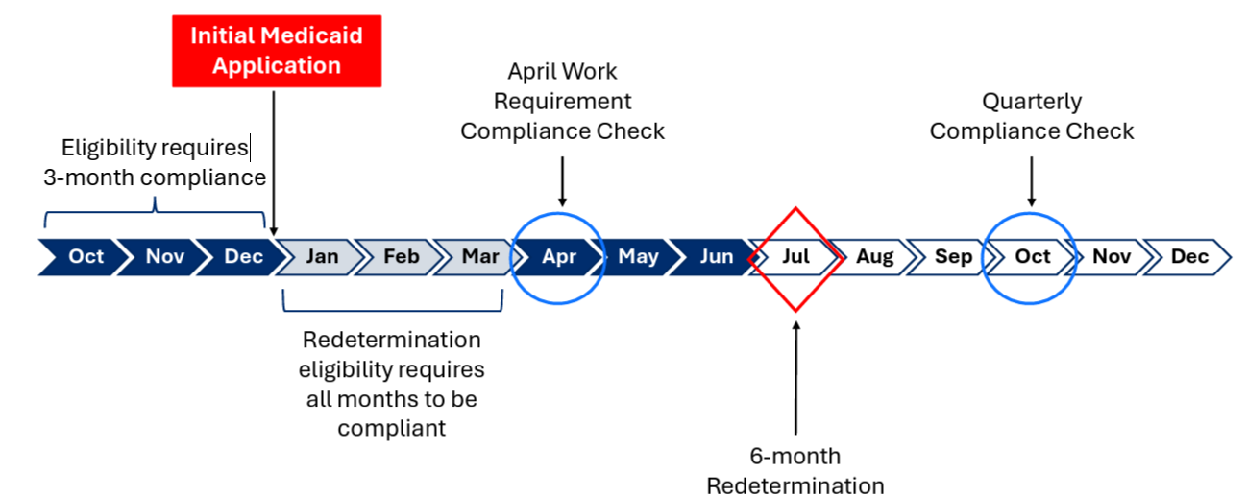

Community Engagement | Work Requirement Timeline
Source: FSSA SFY26 Q3 Quarterly Financial Review (pg 228) – April 28, 2026

Slide 19
Community Engagement | Verification Process
1. Member Reviewed
Notice of Appeal Rights ⚠
2. Excluded or Exempt?
3. Community Engagement Required
NO
4. Activity Verified?
Requirement NOT satisfied ⚠
YES
NO
Requirement Satisfied ✅
YES
Coverage Continues✅

Slide 20

Indiana Medicaid Programs

Slide 21
Indiana Medicaid Programs
Indiana Medicaid includes Traditional, or Fee-For-Service (FFS) Medicaid and managed care plans through the Managed Care Organizations (MCOs) listed below
  Traditional Medicaid or Fee-For-Service (FFS)
  Managed Care Medicaid
    Healthy Indiana Plan (HIP)
    Hoosier Care Connect
    Hoosier Healthwise
    Indiana PathWays for Aging (PathWays)
Managed Care Organization (MCO) | HIP | Hoosier Health Connect | Hoosier Healthwise | PathWays
Anthem | X | X | X | X
CareSource | X |  | X
Humana |  |  |  | X
Managed Health Services (MHS) | X | X | X
United Healthcare |  | X |  | X

Slide 22
Indiana Medicaid Programs | Fee-For-Service (FFS)
Fee-For-Service (FFS): Services are reimbursed on a per-service basis, and members can seek services from provider that are enrolled in IHCP
Traditional Medicaid – Package A benefits for members that qualify
  Those eligible for a Home and Community-Based Services (HCBS) waiver, under the age of 60, dully eligible with Medicare/Medicaid, reside in a nursing facility. Those of any age that reside in an intermediate care facility for individuals with intellectual disability (ICF/IID) or in another non-nursing facility institution.
590 Program
Family Planning Eligibility Program
Home and Community-Based Services (HCBS) – excluding the PathWays Waiver
Medicaid Rehabilitation Option (MRO)
Medical Review Team (MRT)
Medicare Savings Programs
Emergency Services Only (See the Member Eligibility and Benefit Coverage module)
Presumptive Eligibility (PE)

Slide 23
Indiana Medicaid Programs | Healthy Indiana Plan (HIP)
Healthy Indiana Plan (HIP): ages 19 to 64 who meet specific income levels
  HIP Plus - Members are initially enrolled in HIP Plus, which includes vision, dental and chiropractic benefits. Members pay a monthly POWER account contribution based on income. Copayments are not required, except for non-emergency use of the emergency room.
  HIP Basic - Members with household income at or below 100% of the federal poverty level who do not make their POWER account contributions are moved to HIP Basic. Benefits are reduced; essential health benefits are covered, but vision and dental services are not. Members must pay copayments for most services.
Managed Care Entity (MCE) | HIP
Anthem | X
CareSource | X
Managed Health Services (MHS) | X

Slide 24
Indiana Medicaid Programs | Hoosier Care Connect
Hoosier Care Connect: ages 59 and younger, are not eligible for Medicare and includes individuals that are;
Managed Care Entity (MCE) | Hoosier Care Connect
Anthem | X
Managed Health Services (MHS) | X
United Healthcare | X
  Blind
  Disabled
  Receiving Supplemental Security Income (SSI)
  Enrolled in MEDWorks
  Children who are wards of the State, current/former foster children or who are receiving adoption assistance may voluntarily enroll in the program
  Members will be transitioned from Hoosier Care Connect to another program if;
    Individual turns 60 years old or becomes eligible for Medicare
    Enters a state psychiatric facility, a psychiatric residential treatment facility (PRTF) or an intermediate care facility for individuals with intellectual disabilities (ICF/IID)
    Becomes eligible for and chooses to enter a Home and Community Based Services (HCBS) waiver program
    Enters a nursing home for a length of stay (LOS) greater than 30 days

Slide 25
Indiana Medicaid Programs | Hoosier Healthwise
Hoosier Healthwise: for children up to age 19 and pregnant individuals
  Package A - for children and pregnant individuals, no cost-sharing obligations
  Package C - for children up to age 19 that are enrolled under Children's Health Insurance Program (CHIP). Under CHIP, members are required to pay a monthly premium for coverage as well as copays for certain services
Managed Care Entity (MCE) | Hoosier Healthwise
Anthem | X
CareSource | X
Managed Health Services (MHS) | X

Slide 26
Indiana Medicaid Programs | PathWays for Aging
Indiana PathWays for Aging: for older adults, ages 60 and older who receive Medicaid or are dully enrolled in Medicare and Medicaid
  Medicaid benefits are not expanded through PathWays, but a member selects a health plan that will manage their care
  PathWays Dual Care Program launched January 2026, a program developed around a Fully Integrated Dual Eligible Special Needs Plan (FIDE SNP) to ensure that members receive the highest level of integration
    A FIDE SNP is a type of Dual Eligible Special Needs Plan (D-SNP), and is referred to as PathWays Dual Care in materials
  A care and service coordinator is assigned that assists with developing specialized care and service plans to meet a member’s needs and help access Long-Term Services and Supports (LTSS)
Managed Care Entity (MCE) | PathWays
Anthem | X
Humana | X
United Healthcare | X

Slide 27
Resources and Next Steps

Slide 28
Indiana Medicaid Programs | Resources
Family and Social Services Administration (FSSA)
  FSSA Benefits Portal
  IHCP Provider Healthcare Portal
  FSSA | HIP: HIP Work Requirements
    Information for Members
    Partner Toolkit
  FSSA Indiana YouTube Channel | HIP Work Requirements Videos
Federal Legislation: HR 1 (OBBB)
State Legislation: SB 1
CMS Interim Final Rule Medicaid Program: Community Engagement Requirement for Certain Individuals (CMS-2454-IFC)
National Council for Mental Wellbeing | H.R. 1 Hub

Slide 29
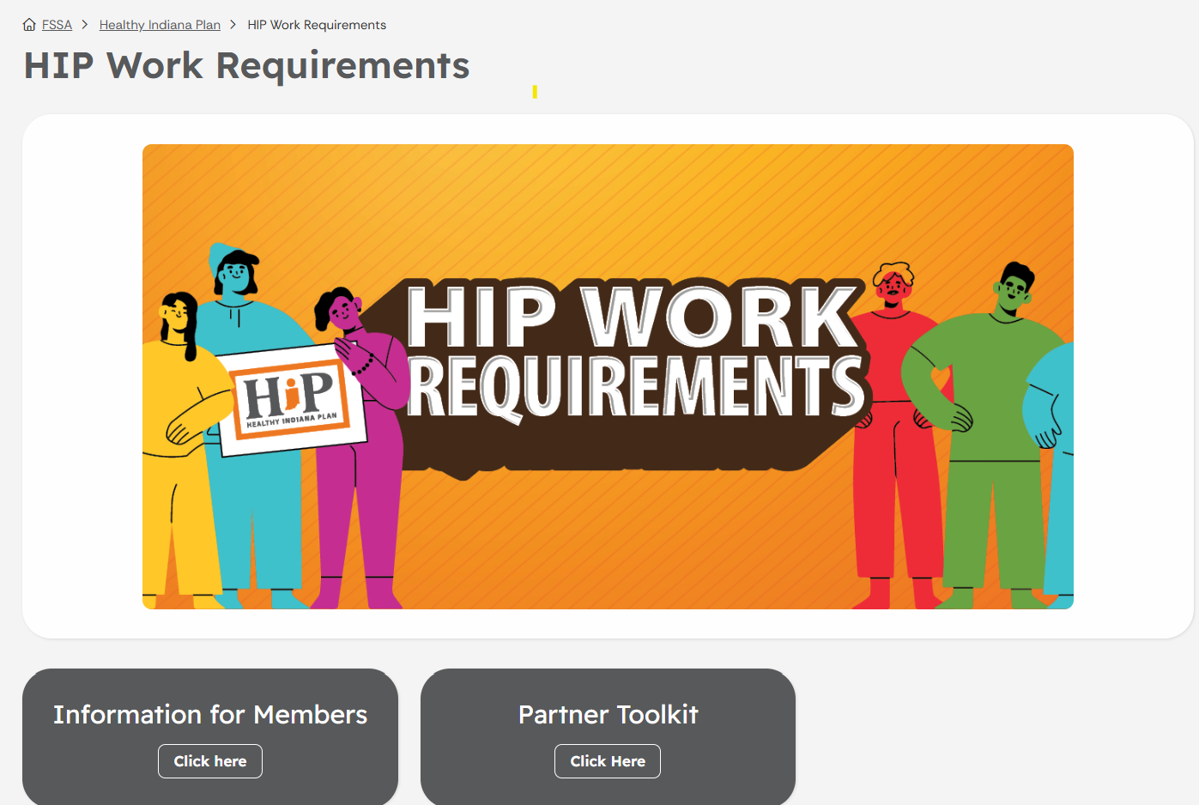
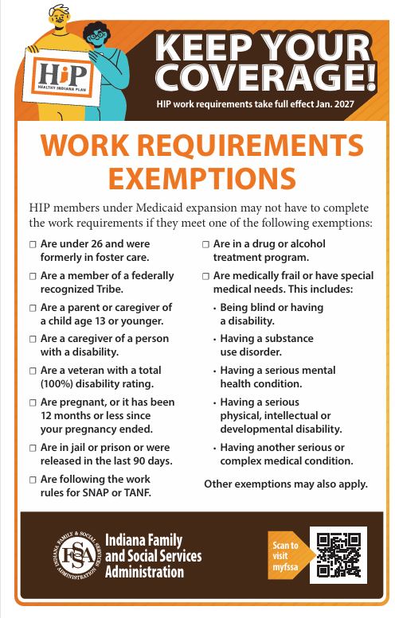

Community Engagement | Partner Toolkit
English
Spanish
FSSA | HIP: HIP Work Requirements
  Information for Members
  Partner Toolkit

Slide 30
Community Engagement | Next Steps
Ensure members update their contact information through the benefits portal
Confirm individuals are in the correct plan or benefit category
  Traditional Medicaid, Hoosier Care Connect and Hoosier Healthwise members are not subject to work requirements
Establish a process to verify anyone that may meet medically frail, disabling mental disorder criteria or have a qualifying ICD-10 codes for exemption
Strengthen documentation of SMI, SUD and functional impairments
Ensure all staff, especially front office and care coordination teams, understand the community engagement requirements and verification process
Educate patients on requirements, exemptions, deadlines and appeal rights
Flag members at risk of coverage loss due to reporting or redetermination issues
Monitor eligibility and exemption issues, terminations and exemption outcomes to inform advocacy

Slide 31


Community Engagement | Questions?
Questions?

