Slide 1
Employment Resources for Job Seekers and Employees with Disabilities
Bureau of Rehabilitation Services
Division of Disability, Aging and Rehabilitative Services

Slide 2
Benefits of Employment
Greater economic self-sufficiency
Increased confidence and self-worth
Opportunity for skill development and advancement
Expanded social networks
Increased independence and control over life
Notes:
As you can see here, there are several benefits of employment for individuals with disabilities.

Slide 3
Barriers & Challenges
Low Expectations
Misperceptions on Accommodations
Lack of Awareness
Notes:
And these are barriers/challenges for participants and their parents/guardians/families as well as employers.

Slide 4
Workforce Resources
Notes:
I’d like to examine not only resources available from VR, but other agencies and programs given that many of these are available to all individuals, including individuals with disabilities.

Slide 5
Workforce Innovation and Opportunity Act (WIOA)
The Workforce Innovation and Opportunity Act (WIOA) was signed into law on July 22, 2014. WIOA is designed to help job seekers access employment, education, training, and support services to succeed in the labor market and to match employers with the skilled workers they need to compete in the global economy.
https://www.dol.gov/agencies/eta/wioa/programs
Notes:
Title IV of WIOA recognizes state VR agencies as a core partner in the workforce development system, strengthening the alignment of the VR program with the other core programs of the workforce development system through unified strategic planning requirements, common performance accountability measures, and requirements governing the one-stop delivery system.
WIOA strengthens the foundation for the establishment of a comprehensive, accessible, and high-quality workforce development system that serves all individuals in need of education and employment services, including individuals with disabilities, and employers in a manner that is customer-focused and that supports an integrated service delivery model.
In other words, it was designed to help agencies work and collaborate together for the betterment of job seekers with and without disabilities.

Slide 6
WIOA
WIOA is landmark legislation that is designed to strengthen and improve our nation's public workforce system and help get Americans, including youth and those with significant barriers to employment, into high-quality jobs and careers and help employers hire and retain skilled workers.
https://www.dol.gov/agencies/eta/wioa/programs
Notes:
The law authorizes increased access to employment, education, training, and support services to assist individuals with disabilities, including youth and students with disabilities, to succeed in the competitive labor market.

Slide 7
DDARS
Division of Disability, Aging and Rehabilitative Services

Slide 8
Vocational Rehabilitation
Vocational Rehabilitation (VR) partners with individuals with all types of disabilities to assist them in achieving their employment goals.
Employment goals are based on the individual’s interests, strengths, and priorities.
The focus is on employment:
Preparing for employment: training, job skills development
Obtaining employment: job search and job development
Retaining employment: short and long term supports
Advancement in employment: career pathways
Notes:
The purpose of VR is to help job seekers with disabilities to prepare for, obtain, retain or maintain, and advance in employment.
Employment goals are identified collaboratively between the job seeker, the VR Counselor, and potentially others, taking into consideration the job seeker’s preferences.

Slide 9
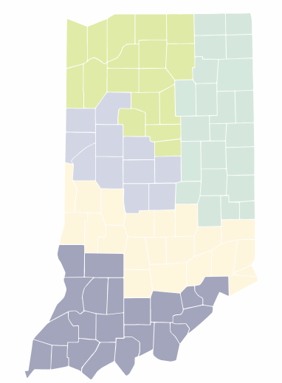
VR operates in all 92 Indiana counties
  VR Office location information is available online.
  Referrals can be made in person at a local office, via telephone call, email, or using the online referral form.
Notes:
Statewide VR Office location information can be accessed from the VR website (www.vrs.in.gov). Job seekers can apply in person at an office location, or via telephone.
Additionally, job seekers can complete an online referral at https://www.in.gov/fssa/ddrs/rehabilitation-employment/vocational-rehabilitation-employment/vocational-rehabilitation-application/.

Slide 10
VR Eligibility Criteria
The applicant must have a physical or mental impairment
1
That physical or mental impairment must constitute or results in a substantial barrier to employment
2
The individual must require one or more VR services to achieve a competitive, integrated employment (CIE) outcome
3
The individual must be able to benefit from VR services in terms of a CIE outcome
4
Notes:
Individuals who receive SSI or SSDI due to their own disability are automatically eligible.
Competitive Integrated Employment (CIE) is defined as
Full-time or part-time employment for which the individual is compensated at or above the federal minimum wage, but not less than the customary wage and level of benefits paid by the employer for the same or similar work performed by individuals who do not have disabilities
Employment is in integrated setting (employee with a disability has same level of interaction with co-workers, supervisors, customers, vendors, etc. as employees without disabilities, in the work unit and across the entire work site)
Employee with disability has same opportunities for advancement as individuals without disabilities who have similar positions

Slide 11
Process
Application
Eligibility
Plan
Service Delivery
Goal Achievement
Notes:
Federal regulations require eligibility determinations be made within 60 calendar days of application and the individualized plan for employment to be developed and implemented within 90 calendar days of eligibility determination. However, in calendar year 2024, the average length of time to determine eligibility was 34 days, and eligibility to plan was 42 days. Counselors must make eligibility determinations as soon as they have sufficient information to make the determination and typically initiate a plan at the first meeting with the participant after eligibility determination.

Slide 12
Potential Services
Vocational Guidance and Counseling
Physical and Mental Restoration
Rehabilitation Technology
Training
Job-related Services
Supported Employment
Consultation and Technical Assistance
Notes:
This is a listing of the major service categories which may be available to VR participants based on their specific employment goals and needs. VR may also provide additional services as required to assist participants in achieving their employment goals.

Slide 13
Goal Achievement & Program Exit
Once an individual achieves their employment goal, VR will help to ensure the individual reaches stabilization (when the participant achieves their maximum level of independence on the job).
The case will remain with VR for at least 90 days after stabilization, before the case is closed successfully (program exit).
Notes:
Stabilization is unique to the individual, and can be achieved immediately or up to 24 months (48 months for youth meeting specific criteria).

Slide 14
Contacting VR
If you or someone you know might benefit from VR, contact the local office nearest you.

Slide 15
WorkOne
The Core of the Indiana Department of Workforce Development's (DWD) Workforce Development System

Slide 16
WorkOne
WorkOne helps individuals find a new or better job, choose a career, find a good employee, access training, or get the information needed to succeed in today's ever-evolving workplace.
Notes:
WorkOne offices are administered under the Indiana Department of Workforce Development (DWD), which is overseen federally by the U.S. Department of Labor (DOL). WorkOne offices are operated by entities contracted with the DWD to deliver DOL services.

Slide 17
WorkOne Programs
Workforce Ready Grant
Employer Training Grant
INTraining
Dislocated Worker Program
Jobs for America’s Graduates (JAG)
Unemployment Insurance
Adult Education
Notes:
Here are some of the programs that provided by WorkOne locations.

Slide 18
WorkOne Individualized Services
Skills evaluation
Career planning
Resume development
Interview coaching
Job search assistance
Notes:
WorkOne locations provide job seekers with individualized services to help them achieve their employment goals.

Slide 19
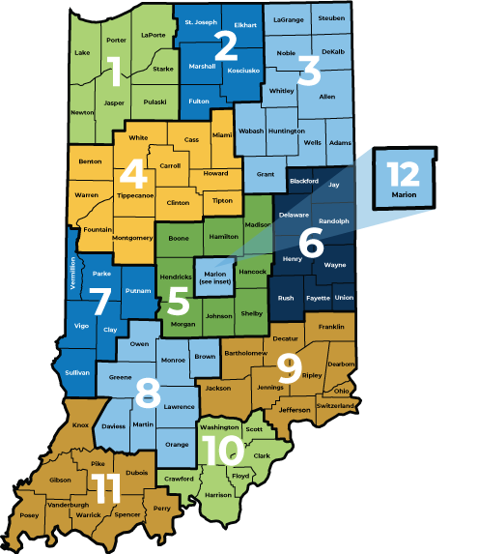
Find you local WorkOne using this interactive map with detailed information about services, location and contact information, and operating hours.
Notes:
There are 12 WorkOne regions in Indiana covering all 92 counties. Job seekers can use the interactive map at the link in the slide for more information.

Slide 20
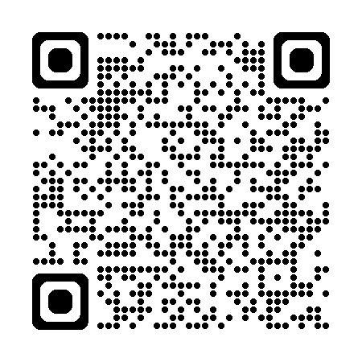
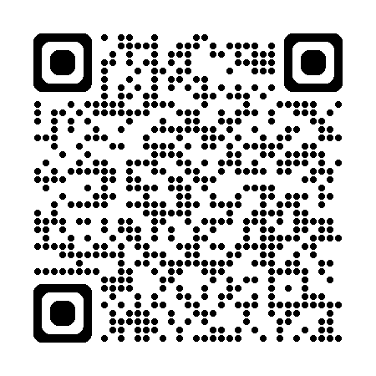
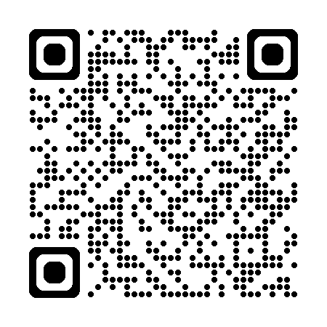
DWD Online Resources
Indiana Career Explorer
Indiana Career Connect
Click on the links or scan the QR code for these resources
INDemand Jobs
Notes:
The DWD offers online resources such as Indiana Career Explorer, Indiana Career Connect, and INDemand Jobs to help job seekers research and apply for employment opportunities within the state.

Slide 21
Additional Resources
Notes:
We are now going to look at some additional resources which job seekers can access to help with their employment goals.

Slide 22
Work Incentives Planning and Assistance
WIPA staff provide information about work and benefits to people who receive Social Security Disability Insurance (SSDI) or Supplemental Security Income (SSI) because of a disability.
How work impacts benefits
Information about available resources to maximize earnings while protecting benefits
Notes:
WIPA helps job seekers who receive SSDI or SSI due to a disability with information on how working will impact these and other benefits.

Slide 23

Work Incentives Planning and Assistance
In Indiana, there are two WIPA providers:
Indiana Works Northern and Central Indiana
Indiana Works Southern Indiana
Notes:
Indiana has two WIPA providers: Indiana Works Northern and Central Indiana and Indiana Works Southern Indiana. Job seekers can access more information at the links on this slide.

Slide 24
Individual Network Supports
Employers provide reasonable accommodations for employees with disabilities, such as:
  Modified workstations
  Modified work schedules
  Natural supports
  Assistive/adaptive equipment
Most employers provide other employee resources and access to programs that may be beneficial
Notes:
Employer-provided accommodations are adjustments made in the workplace to help employees with disabilities perform their essential job functions. Many of these are free or have a low cost. If accommodation needs go beyond what the employer can provide, they can work in partnership with VR to help meet the employee’s needs. Natural supports refer to unpaid, informal relationships at work to promote the individual's success. Many employers also offer other resources that might be helpful to employees with disabilities. For instance, wellness programs or free training.

Slide 25
Individual Network Supports
College career centers and disability services offices provide many beneficial services. Check with your educational institution's career center and/or disability services offices.
  Postsecondary accommodations
  Resume development
  Interviewing skills training
  Job search assistance
  Community supports like transportation, technology assistance, food security, and mental health resources
Notes:
Ivy Tech operates a program called ‘Ivy Cares’ which is one program that is a great example of community supports. “IvyCares is here to assist you with finding additional campus and community support throughout your academic journey. Sometimes called ‘wraparound services,’ IvyCares focuses on helping students connect with resources in the following areas: emergency transportation assistance, food security, mental health resources, technology assistance, and emergency aid funding.”

Slide 26
Individual Network Supports
Community resources
  Transportation services (public or private)
  Information and referral services (Centers for Independent Living)
  Advocacy organizations
  Local service organizations (food pantries, utility assistance, etc.)
Notes:
Additionally, job seekers can access several other supportive services in their communities, such as public transportation services, including those specialized for individuals with disabilities, as well as information and referral and advocacy services (which may be obtained from one of the Centers for Independent Living (CILs) around the state (see link in slide), or from location service organizations (faith-based as well as public entities) for food pantries, utility assistance, clothing, and more.

Slide 27
Individual Network Supports
Supports from family and friends
  Job search assistance
  Transportation support
  Promoting independence and self-advocacy
  Help with accessing community resources
Notes:
It’s also important for job seekers to consider their own individual network of supports in family and friends who can provide additional assistance with finding and succeeding on the job.

Slide 28
Additional Resources
Indiana Assistive Technology Act, or INDATA provides device demonstrations, device loans, reutilized computers and equipment, and other assistive technology services
Centers for Independent Living provide peer counseling, information and referral, individual and systems advocacy, independent living skills training, and services to facilitate transitions from institutional to community settings, and from youth to postsecondary life.
IN*SOURCE helps parents and children with disabilities navigate the special education process in Indiana, helping to bridge the gap between schools and parents.
Notes:
Here are three other important resources available: The Centers for Independent Living already mentioned, as well as INDATA and IN*Source.

Slide 29
Services for Individuals with SMI (Severe Mental Illness)
Since 2021, VR has partnered with the Division of Mental Health and Addiction to implement an evidence-based approach to employment for people with SMI.
This model is called Individual Support and Placement (IPS), and it is being enacted at 3 sites within the state, with plans for eventual expansion.

Slide 30
Individual Placement and Support
Individual Placement and Support is a novel approach to employment for people with SMI and substance abuse in Indiana. We currently operate programs at the following agencies:
Aspire of Indiana (Marion, Boone, Hamilton counties)
Northeastern Center (Noble, DeKalb, LaGrange)
INcompass Healthcare (Dearborn)

Slide 31
VR and IPS
As opposed to lengthy work trials, assessments, and requirements for medication adherence and sobriety in order to obtain employment, IPS focuses on engaging with work immediately, integrating services with mental health treatment teams, and ensuring no one is excluded from services. VR changed some processes, billing metrics, and paperwork in order to make this program possible.

Slide 32
Principles of IPS
Rapid Job Search/Engagement | Zero Exclusion
Guaranteed Benefits Consulting | Time-Unlimited Supports
Worker Preferences and Strengths | Integration of Employment Services and Mental Health Services
Focus on Competitive Employment | Systematic Job Development

Slide 33
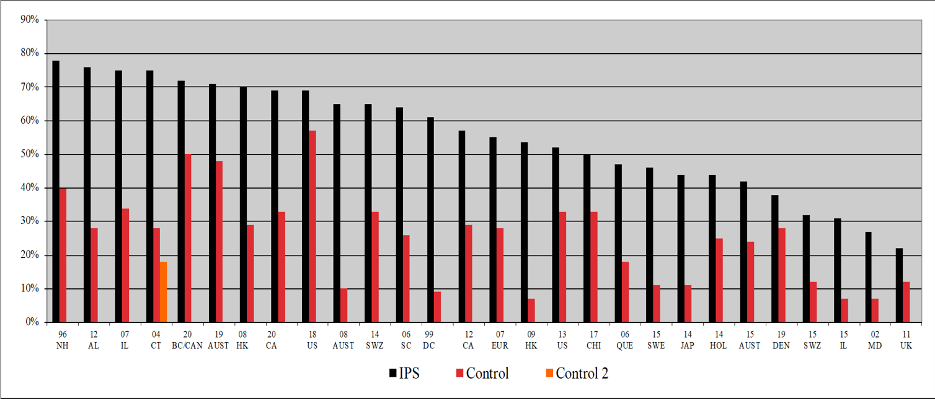
Why IPS?
Bond, G. R., Drake, R. E., & Becker, D. R. (2020). An update on Individual Placement and Support. World Psychiatry, 19, 390-391.

Slide 34
IPS Questions/Resources
Emily Singer – IPS Trainer
Emily.singer@fssa.in.gov
Susan Gray
Susan.gray@fssa.in.gov
Steve Upchurch
Steve.upchurch@fssa.in.gov

Slide 35
Additional Resources
Career OneStop
Community Resources by VR Area Office
FSSA Resource Guide
Job Accommodation Network
Learn More Indiana
My Next Move
Notes:
Finally, on this screen, there are a handful of other online resources which job seekers can utilize.

Slide 36
Thank you!

