Slide 1


INDIANA COUNCIL
Summer Conference and Business Meeting
Notes:
Mention New Website
Mention New Member area

Slide 2

Our Why
Our WHY Statement:
To optimize the health and wellbeing of all people in Indiana through mental health leadership, collaboration & advocacy.

Slide 3
Thank you
Staff
Speakers
All of you…CMHCs, new affiliate members, key collaborators
Partners and Sponsors

Slide 4
How to Access Presentations
The conference agenda is available for reference on our website well as the event app.
Downloading the Event App:
• Download “My Glue”
• If you don’t already have an account within GlueUp, you will be required in order to access the event information
Location of Events:
• Wednesday’s committee meetings will be taking place at Tin Caps Stadium, 1301 Ewing St. Fort Wayne (approximately 1 block from the host hotel, Courtyard by Marriott) in the Lincoln Financial Event Center (near the main entrance of the stadium)
• Thursday’s sessions will be at the Courtyard by Marriott 1st floor conference room, 1150 S. Harrison St. Fort Wayne
• Thursday’s PAC Reception will take place back at Tin Caps Stadium
• Friday’s Business Meeting will take place at the Tin Caps Stadium 2nd Floor Suite Level Lounge
Parking information: The hotel is offering our attendees $8/day for parking in the attached garage.
To access our conference presentations:
1. Presentations will be available in the event app
2. As always, presentations will be available at the conclusion of the conference on our website

Slide 5
Housekeeping Items
Where are the bathrooms located?
What is the Wifi?
Everything is online/new APP

Slide 6
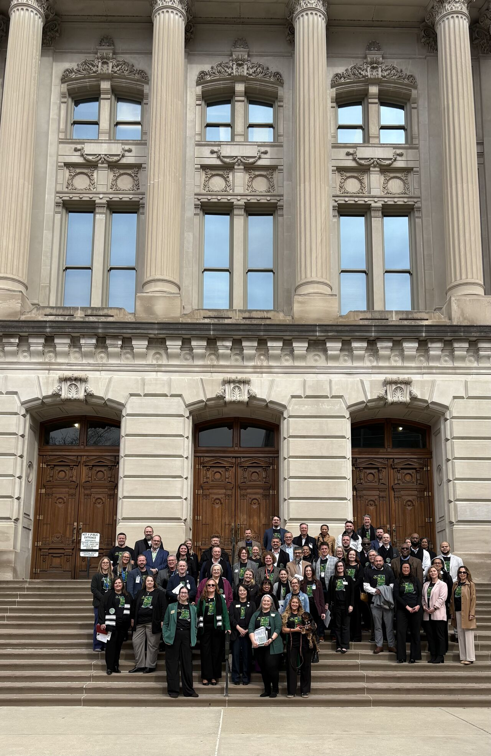

Welcome
First time guests
Members
Affiliate Members
Partners
Sponsors
Speakers

Slide 7
Agenda Review- Thursday, July 9
8:00 – 9:00 Breakfast
9:00-9:05 Breakfast Sponsor- Caresource
9:05 – 9:30 Zoe update
9:30 – 10:30 DCS Austin
10:30-10:45 Break
10:45-11:45 Department of Correction- Neil Duchac
11:45-12:30 Lunch
12:30 – 12:55 Visit Exhibitors
12:55-1:00 Lunch Sponsor- Molina
1:00 – 2:00 Emily Singer, Update on Employment Services
2:00 – 3:00 Indiana Medicaid Community Engagement Update Amanda Deaton
3:00 – 3:15 Break
3:15 – 4:15 DMHA Youth Services and DMHA Update- Sarah Sailors
Sponsored Reception & PAC FUNDRAISING EVENT 5:00 – 6:45 Batting Cages

Slide 8
Agenda Review
Friday, July 10
8:00 – 9:00 Breakfast
9:00-10:00 Indiana Council/Policy Updates
10:00-10:30 Indiana Council Strategic Plan
10:30-10:45 Break
10:45-11:45 Legal Updates, Suzannah Overholt
11:45-12:00 Wrap-up & Next Steps

Slide 9


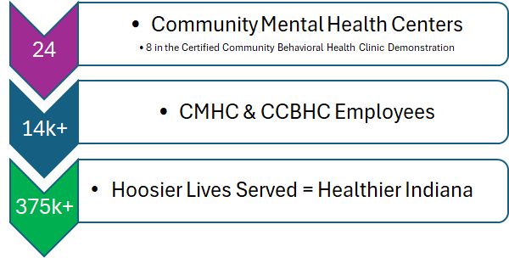

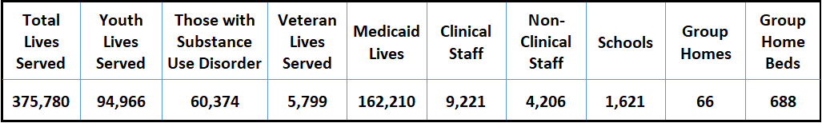
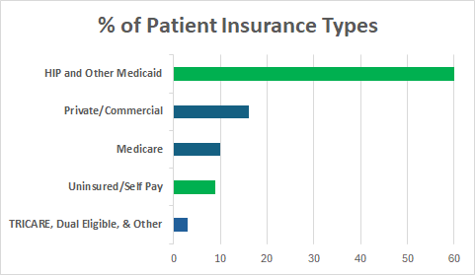
Indiana CMHCs' Impact on Local
Communities and Hoosier Lives
Access to high quality,
comprehensive behavioral health care
Development of behavioral health workforce
Addressing the behavioral health care
needs of underserved communities
Innovative service delivery approaches
Indiana CMHCs' Collective Profile*
Top 3 Primary Diagnoses - Youth:
Top 3 Primary Diagnoses - Adults:
Top 3 Referral Sources:
Self, Family, or Guardian
A Hospital or Physician
Child or Youth Services
Attention-Deficit/Hyperactivity Disorder, Combined Type
Generalized Anxiety Disorder
Post-Traumatic Stress Disorder
Generalized Anxiety Disorder
Major Depressive Disorder, Recurrent, Moderate
Post-Traumatic Stress Disorder
*Data from SFY25 County Reports and Indiana Council Member Profile
indianacouncil.org
Indiana Council of Community Mental Health Centers
PO Box 609, Jeffersonville, IN 47131
(317) 684-3684

Slide 10
Save the Dates
July 14- Cup of Joe- New DMHA Leadership
August 7 – Mental Health Roundtable Summit- First Responder/Military
August 11-Cup of Joe- Eric Yazel- Rural Health MOC Initiative
September 8 –Cup of Joe-Katrina Norris- Behavioral Health Workforce Initiative
September 30- In person Committee meetings
October 1-2- Council’s 50th Anniversary Celebration and CCBHC Fall Conference

Slide 11

Some things are worth celebrating
Nancy and Sydney Work Anniversaries
Readiness checklists and progress being made
Crisis funding
SAMHSA CCBHC funding
CCBHC Impact Report

Slide 12
Behavioral Health in Aging Certificate
Funded by Humana Grant
Behavioral Health in Aging Certificate Program from Boston University
Self-paced and online, at NO COST to centers
6-9 months to complete if dedicating 1-2 hours per work to the training
Primarily for OBHPs and front-line staff to better serve the aging population
Send rosters to Amanda Deaton – adeaton@indianacouncil.org
Links to program information:
https://thenetwork.bu.edu/ncoa-training-portal/cader-behavioral-health-in-aging-certificate-program/
https://thenetwork.bu.edu/ncoa-training-portal/cader-eoea-person-centered-case-management-behavioral-health-in-agingcourses/

Slide 13
Know any potential New Members?
The Indiana Council has approved expansion of membership to represent other nonprofit mental health and substance use providers that share the same vision as the council and its members. If you have any recommendations on good partners for us to reach out to please let Lee Ann Jordan at ljordan@indiancouncil.org.
The Indiana Council PAC Donation is active online
The Indiana Council PAC is a way we as members can show our legislators support as we collaborate with them on public policy. Anyone who donates will receive a lapel pin that states your support for Mental Health. It is a wonderful way to show your support of mental health and substance use policy at the State House.
The link to donate is - https://raisedonors.com/indianacouncil/donation-page
Council Announcements

Slide 14
INDIANA COUNCIL
Business Meeting
Notes:
Mention New Website
Mention New Member area

Slide 15
Agenda Review
Friday, July 10
8:00 – 9:00 Breakfast
9:00-10:00 Indiana Council/Policy Updates
10:00-10:30 Indiana Council Strategic Plan
10:30-10:45 Break
10:45-11:45 Legal Updates, Suzannah Overholt
11:45-12:00 Wrap-up & Next Steps

Slide 16
Council Updates
CCBHC Evaluation Members Needed
HR turnover review Members Needed
Member profiles and Dues
Email Hack
Glue up Update
EDO examples
Sph examples
Project aware
CCBHC readiness checklists

Slide 17
2026 Strategic Plan Review

Slide 18
Legislative & Policy Impact
Election Update – New legislators, 50 new sheriffs, approx. 33 new prosecutors
State Policy Update
  CCBHC
  Crisis
  Rural Health Funds- Behavioral health workforce, IT, MOC
  SB 285
  SB 1
  Salary Language
  Fraud, Waste and Abuse

Slide 19
Legislative & Policy Impact
Federal Policy Update
  CCBHC
  Budget Allocations
  SAMSHA – Substance Use Disorder RFI Comments Submitted
  DOL – Workforce Wage
  DOE Update- Law suit filed
  HB 1- Community engagement – Lawsuit filed
  SPH Ruling
  Fraud, waste and abuse

Slide 20

Ensuring Excellence in Mental Health Act of 2025
Bill Number: S.3402/ H.R.8487
Sponsors: Sens. Cornyn (R-TX), Tillis (R-NC), Smith (D-MN), and Cortez-Masto (D-NV)
Bill Summary:
  Establishes CCBHCs under Medicare
  Solidifies the PPS under Medicaid
Updates CCBHC-E grants authorizing language
  Create opportunities to better integrate physical and behavioral health care
  Further enhance the strong accountability measures for CCBHCs
  Urge your members of Congress to support the bill!

Slide 21
Data Warehouse Advancement
Working with IPCHA on a shared data warehouse with Azara
Still Standardizing data collection across 24 CMHCs/CCBHCs with the state
Positioning members for value-based and CCBHC reimbursement models

Slide 22
Clinical Integration Network (CIN) Progress
Planning for statewide CIN
Creating shared quality and outcome measurement framework
Establish foundation for payer contracting alignment
Enhanced collaboration across member agencies
Positioned network for future shared savings opportunities

Slide 23
Crisis & Access Infrastructure
Stabilization planning for non-demo crisis services
Advocacy for short-term crisis funding solutions
Alignment of billing strategies across payers
Focus on CCBHC sustainability

Slide 24
Member Support & Engagement
Increased state and federal legislative engagement
Strengthened state agency relationships (DMHA, FSSA, Medicaid)
Continued committee collaboration- streamlined committees
Revenue and billing and grant support

Slide 25
FY 2027 Plan review
CCBHC Permanency In Indiana
ICCMHC is Agile and a business leader
Revenue Diversification
Rebranding
Updating bylaws and member standards

Slide 26

Review Current Issues List
Current Issues List --New Format--.xlsx

Slide 27
Behavioral Health in Aging Certificate
Funded by Humana Grant
Behavioral Health in Aging Certificate Program from Boston University
Self-paced and online, at NO COST to centers
6-9 months to complete if dedicating 1-2 hours per work to the training
Primarily for OBHPs and front-line staff to better serve the aging population
Send rosters to Amanda Deaton
Links to program information:
https://thenetwork.bu.edu/ncoa-training-portal/cader-behavioral-health-in-aging-certificate-program/
https://thenetwork.bu.edu/ncoa-training-portal/cader-eoea-person-centered-case-management-behavioral-health-in-agingcourses/

Slide 28
Know any potential New Members?
The Indiana Council has approved expansion of membership to represent other nonprofit mental health and substance use providers that share the same vision as the council and its members. If you have any recommendations on good partners for us to reach out to please let Lee Ann Jordan at ljordan@indiancouncil.org.
The Indiana Council PAC Donation is active online
The Indiana Council PAC is a way we as members can show our legislators support as we collaborate with them on public policy. Anyone who donates will receive a lapel pin that states your support for Mental Health. It is a wonderful way to show your support of mental health and substance use policy at the State House.
The link to donate is - https://raisedonors.com/indianacouncil/donation-page
Council Announcements

Slide 29
Save the Dates
July 14- Cup of Joe- New DMHA Leadership
August 7 – Mental Health Roundtable Summit- First Responder/Military
August 11-Cup of Joe- Eric Yazel- Rural Health MOC Initiative
September 8 –Cup of Joe-Katrina Norris- Behavioral Health Workforce Initiative
September 30- In person Committee meetings
October 1-2- Council’s 50th Anniversary Celebration and CCBHC Fall Conference

Slide 30
Thank you
Staff
Speakers
All of you…

